Slide 1
Reaching the Public: Taking Science Directly to the Public through Books, Op-eds, and Public Appearances
Leah Ceccarelli
nSCI Conference, Journals and Science
November 14, 2013

Slide 2
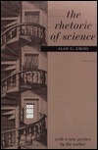
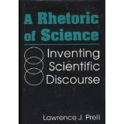
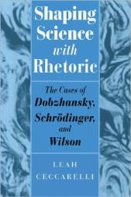
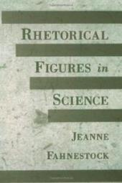
Rhetoric of Science
The application of concepts developed in the humanities to analyze and evaluate the persuasive communication of scientists

Slide 3
Preview
Terms of art to be introduced:
hedges, hyperbole, metaphor, litotes, metastasis
Cautionary Tales
Exemplary Cases

Slide 4
Lauren Archer, “Harms of Hedging in Scientific Discourse: Andrew Wakefield and the Origins of the Autism Vaccine Controversy,” Technical Communication Quarterly, in press.
hedge: a word or arrangement of words that limits or qualifies a statement
E.g., “may” “possible” “some” (Wakefield et al., The Lancet, 1992)

Slide 5
Wakefield Press Conference
“It is our suspicion that there may well be [a genuine causal association between MMR and this syndrome] but that is far from being a causal association that is proven beyond doubt”
“as yet we don’t know but there is no doubt that if you give three viruses together, three live viruses, then you potentially increase the risk of an adverse event occurring”

Slide 6
Miles Coleman, “Darwinius Hyperbolicus: The Unconscious ‘Disconnects’ between Scientific Consensus and Exaggerations of Scientific Significance (and Validity) Amidst the Ida Controversy,” National Communication Association, Washington DC, Nov. 2013.
hyperbole: intentional exaggeration for emphasis or effect
Franzen et al, “Complete Primate Skeleton from the Middle Eocene of Messel in Germany: Morphology and Paleobiology,” PLoS ONE, May 19, 2009.

Slide 7
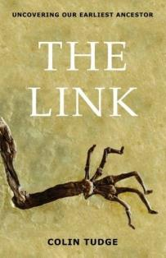
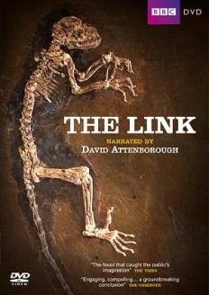

Slide 8
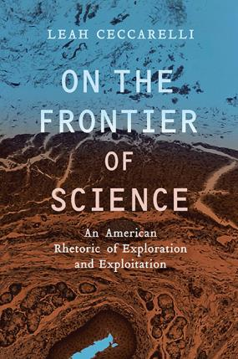
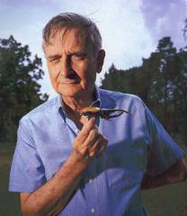
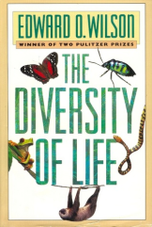
Chapter 3: The Dangers of Bioprospecting on the Frontier: The Rhetoric of Edward O. Wilson’s Biodiversity Appeals

Slide 9
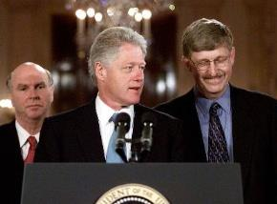
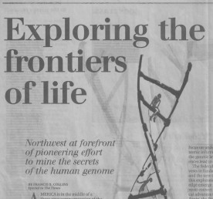
Chapter 4: Biocolonialism and Human Genomics Research: The Frontier Mapping Expedition of Francis Collins

Slide 10
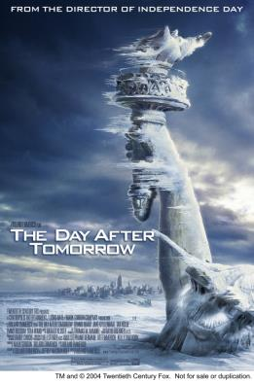
Ron Von Burg, “Decades Away or The Day After Tomorrow?: Rhetoric, Film, and the Global Warming Debate, Critical Studies in Media Communication 29.1 (2012), 7-26.
litotes: a figure of speech that works as an understatement, usually by affirming the negation of its opposite
E.g., “not bad,” “not unwelcome,”
“not untrue,” or “not scientifically invalid”

Slide 11
Leah Ceccarelli, “Manufactured Scientific Controversy: Science, Rhetoric, and Public Debate,” Rhetoric & Public Affairs 14.2 (2011), 195-228.
metastasis: denying and turning back on your opponents the charges that have been directed against you
E.g., countering manufactroversy with fairness claims

Slide 12
Summary
Be careful about the use of hedges in public discourse.
Resist the urge to offer hyperbolic significance claims in public reports.
Think carefully about the metaphors you use in public communication.
When responding to critics, use rhetorical strategies like litotes and metastasis.

