Slide 1
Journals & Science
University of Washington, Seattle
15 November 2013
Ethical and Practical Challenges for Sharing Public Health Data
Claudia I. Emerson, PhD

Slide 2
Consider
Data from cancer and human studies are least likely to be shared
Data sharing in well-funded studies remains low despite explicit requirements from funders
Researchers with the most experience in the field are less likely to share data
“data is least available in areas where it could make the biggest impact” (Piwowar, PLoS One 2011)

Slide 3
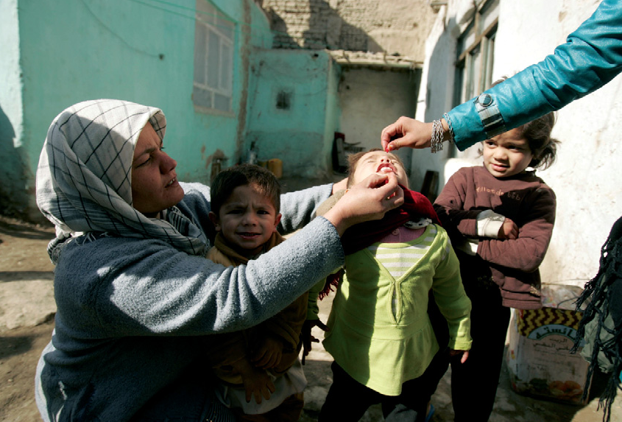
Case: Polio
Researchers have limited access to polio-specific data (e.g. immunization status, genetic sequences) needed for modeling transmission risk and new management strategies
Health agencies are reluctant
to share country data
MOUs must be negotiated
with each country → laborious,
time-intensive, not always
successful
800 hrs to construct and access
datasets on where and when
polio campaigns took place:
a duplication of efforts!

Slide 4
Data sharing
Making data available to others for use in research or other analytic activities
Involves the transfer of data between two or more parties or distribution into the public domain
Can take several forms, e.g. sharing raw data, metadata, models
Also referred to as ‘data access’

Slide 5
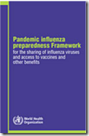
Data sharing is widely promoted…
Sharing research data to improve public health: full joint statement by funders of health research
Notes:
Also, Open Government Partnership (2011)

Slide 6
…but not widely practiced
Limited culture of data sharing in public health
Practical and ethical barriers along the data management lifecycle
Data is about individuals and communities → highly sensitive
Different socio-cultural norms about the value of data
DNA as embodied knowledge, e.g. Maori and Amerindians
Data sovereignty: ownership tied to cultural identity → exportation restrictions, e.g. India, Malawi, Mexico
Insufficient guidance in international ethical codes
collection
access
use
disclosure
retention
disposal
Notes:
Limited culture: getting ‘scooped’, P&C, lack of incentives, rewards, or enforcement;

Slide 7
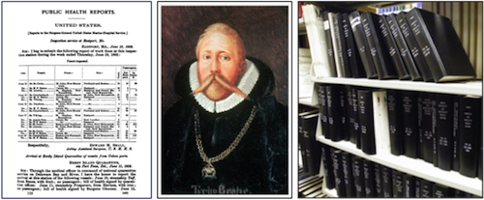
Practical challenges
Limited resources and capacity to collect and process data
Immense challenge in low and middle income countries
Quality and completeness of data
Significant data gaps, e.g. vital registration
Data standardization and integration
Technical solutions widely available in the private sector have not made their way into the public health space
Language barriers; incompatibility of formats
Lack of metadata and standards
Preservation and discoverability→
Data publication and citation
Enforcement of data access
policies: funders, journals
(van Panhuis et al, 2013)
Project TYCHO

Slide 8
Ethical challenges
individuals / communities
informed consent
privacy / confidentiality
risks vs benefits
data source
data producer
data consumer
LMICs
asymmetrical collaborations
investigators / organizations / countries
loss of ownership / control
inequity; exploitation
reciprocity
disclosure risks
trust
benefit-sharing
investigators / organizations / countries
stewardship
justice
disclosure risks
distrust/ mistrust
benefit-sharing
HICs

Slide 9
Ethical challenges
Ownership and control of data: e.g. WHO reluctant to share data from member countries without express consent;
Privacy and confidentiality: e.g. authors bound by confidentiality agreements to their data sources
Distrust: concerns about misuse and misrepresentation of data
Disclosure risks: data scrutiny; potentially damaging or stigmatizing facts revealed, e.g. poor immunization record; impact on trade and tourism resulting in economic harm, legal liability
Inequity / Exploitation: between producers and consumers of data

Slide 10
Needed: a principled approach
Principles →
Express common values and capture the goals that underlie motivation for data sharing
Emphasize moral duty, common purpose and shared interests
Provide a common framework for policy development
‘Anchor the actionables’: principles remain consistent though conventions differ
Adjudicate between competing ethical requirements
Notes:
Data sharing must begin with principles; WEF (2011) report on data as new economic asset class called for the ‘definition of global principles for sharing personal information’; The Joint Statement by funders called for the development of principles

Slide 11
Global Health Data Access Principles
Promotion of the Common Good
Respect
Accountability
Reciprocity
Stewardship
Proportionality
www. docs.gatesfoundation.org/Documents/data-access-principles.pdf

Slide 12
Why these principles?
Elaborate values of public health
Pay special attention to the goal of reducing inequities
Responsive to the ethical challenges
Interoperable: capture the norms articulated by data sharing policies of major public health funders

Slide 13
Data access principles
Promotion of the Common Good
the over-arching principle
Respect
fundamental to interactions between all stakeholders
Emphasis on respect between researchers and collaborators → a critical aspect of data sharing that is often overlooked because the tendency is to focus on respect for research participants
Accountability
Designed to capture both senses of accountability that are important for data sharing:
- One is accountable for making data accessible
- One is accountable for the processes that make data accessible, e.g. quality, security

Slide 14
Data access principles
Stewardship
Analogous to idea of “responsibility” commonly articulated in data sharing policies of major funders
Replaces the concept of ‘ownership’ which can lead to conflict and disputes in data sharing
Recognizes the ‘data trail’ as information is passed from one steward to another
Proportionality
Calls for proportionate evaluation of benefits/risks attained in making data accessible
Reciprocity
Acknowledges the need ‘to give something back’ to those that make R&D possible

Slide 15
Summary
Both ethical and practical issues present barriers to sharing public health data
Technology and ‘policies with teeth’ from funders and publishers of research can address some of the practical barriers
Overcoming ethical barriers is more vexing: involves building relationships, and reconciling different values and norms
Principles that are responsive to the ethical challenges can serve as a starting point for dialogue and policy development to facilitate data sharing

Slide 16
Thank you
Acknowledgments
Polio Modeling & Data Access WG - University of Pittsburgh
claudia.emerson@srcglobal.org

