Slide 1
Notes:
I wanted to thank the organizers for the opportunity to be a part of this wonderful conversation we are having. We have had a fascinating day so far discussing the current status of scientific publishing. I’m going to try something a little different. Let’s see how it goes.

Slide 2
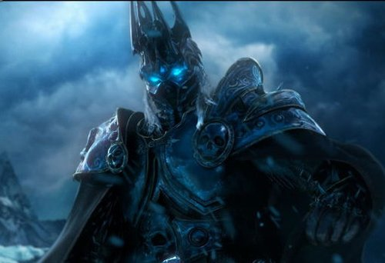
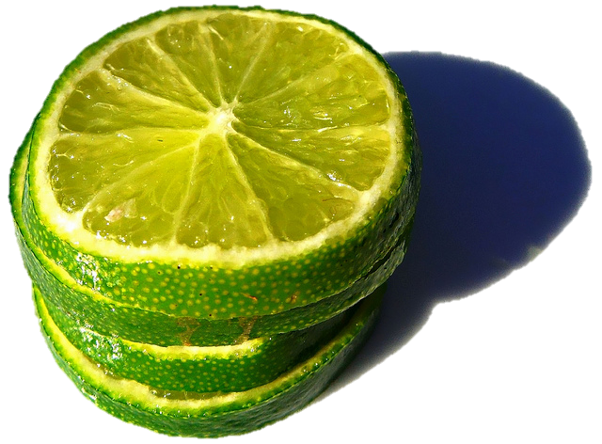
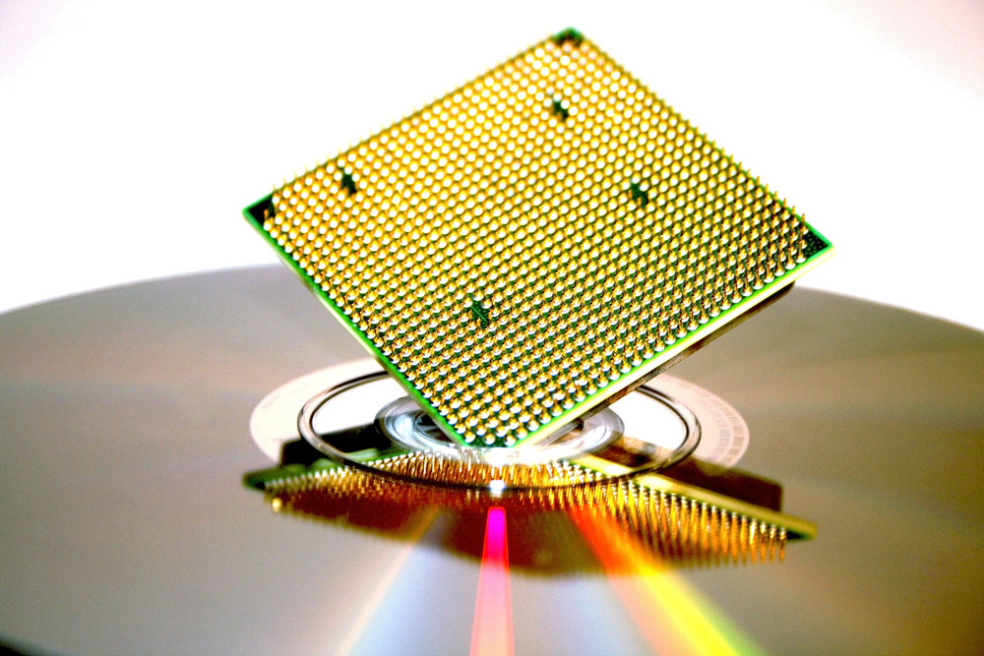
Limes,Warcraft and Computers
by foeock@ flickr
Leveraging Hierarchies and Networks for
Humanity’s Future
by canrocked@flickr
by Darwin Bell@flickr
Notes:
I’m here to introduce the final session examining the Future. I hope to weave a narrative that will help us understand why the current path of scientific communication is not sustainable and how we might craft some solutions. Some solutions we will likely discuss this afternoon. well, we can’t know where we will go if we don’t know where we came from or where we are. So let’s go back in time for a minute.

Slide 3
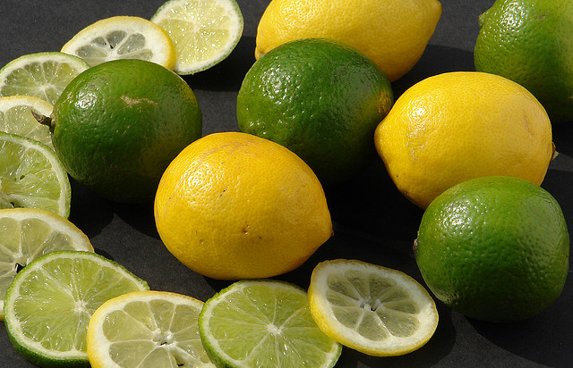
A History Lesson Fruits and Scurvy
How it took the British Navy 250 years to adopt an innovation that saved lives
by robbophotos@flickr
Notes:
Does anyone know why the Brits are called Limeys? Right, due to the use of limes by the navy to prevent scurvy. But I bet you didn’t know how long it took the British to figure that out. Let’s take a look.

Slide 4
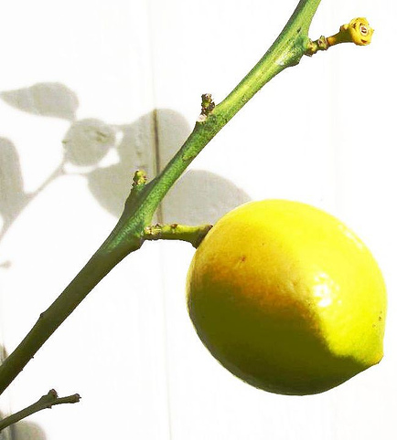
1601 An initial discovery
Four ships
One got lemon juice
No one died of scurvy
On other 3 - 110 out of 278 died by halfway point
by Darwin Bell@flickr
Notes:
The age of Discovery brought not only tremendous new knowledge but also the first signs of nutritional disease. The first documented experiment to investigate this happened in 1601. Everyone on one ship out a group of four ships got lemon juice. No one died. While on the other 3 ships 110 out of almost 300 sailors were dead well before the ships reached land.

Slide 5
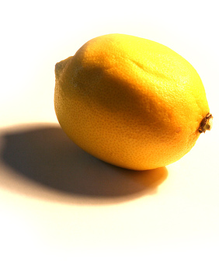
1747 year 146
Scurvy patients got one of five treatments
Only those who got citrus fruits got better
by *saxon*@flickr
Notes:
Nothing was done. Almost 150 years later, the next successful experiment looked at sailors already suffering scurvy. Of the 5 treatments tried, only those getting citrus got well

Slide 6
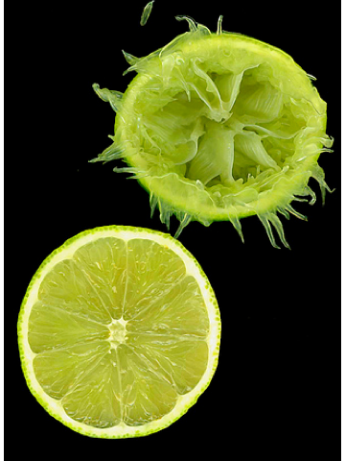
1797 year 196
British Navy mandates limes on all its ships
Scurvy wiped out – in the Navy
by *clairity*@flickr
Notes:
It would be another 50 years, almost 200 years AFTER the first successful experiment, before the British Navy put limes on every vessel and scurvy disappeared from the Navy

Slide 7
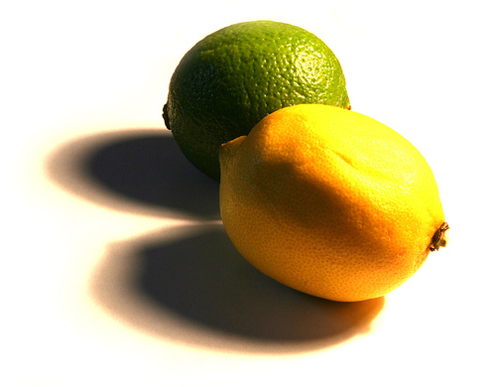
1865 year 264
All British ships, including merchant marine, to have limes
Scurvy wiped out
by *saxon*@flickr
Notes:
But it would be over 60 more years before all British ships were required to have limes. 264 years to fully engage a cure for scurvy.

Slide 8
Why does it take something that is ‘obvious’ so long?
Lack of understanding
Priorities
Complex problem
Incorrect/incomplete data
Social network important
Notes:
Took so long because they did not understand the basics. If officers had been dying, they would have been more concerned. But it was the poorly fed sailors who died. They had a lot of incorrect data fogging up these experiments. Captain Cook said sauerkraut was the way to go and his social status set things back for a generation. The right information was not getting to the right people to permit appropriate actions.

Slide 9
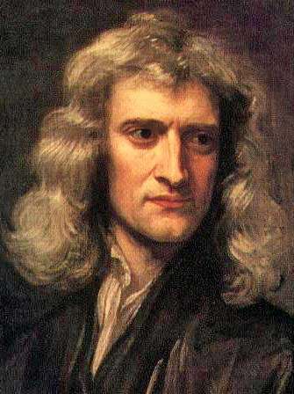
Isaac Newton
“If I have seen further it is by standing on the shoulders of Giants.”
1676
Notes:
Poor scientific communication cost people their lives. The story of limes is not simply a just-so story. Rapid communication of information is important for anyone doing science. Scientists have known for well over 400 years that the work of others is critical for expanding scientific knowledge.

Slide 10
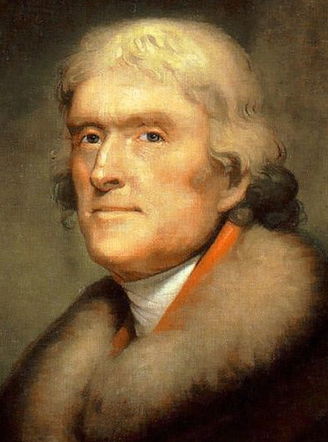
Thomas Jefferson
“He who receives an idea from me, receives instruction himself without lessening mine; as he who lights his taper at mine, receives light without darkening me.”
1813
Notes:
Over the last 400 years, some of the greatest minds in history realized that openness in communication engenders a win-win process that helps many while hurting few.

Slide 11
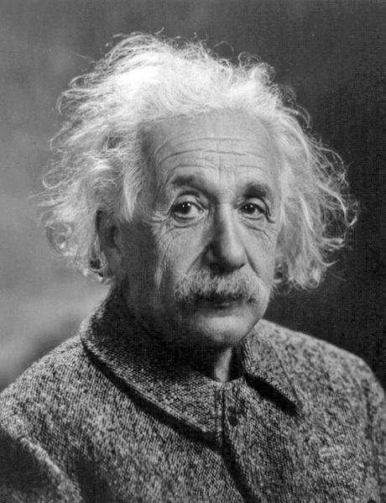
Albert Einstein
“This freedom of communication is indispensable for the development and extension of scientific knowledge, a consideration of much practical import.”
1950
Notes:
Especially during the last century, scientists realized that research requires rapid and open communication in order to create the knowledge needed to understand the world around us.

Slide 12
Inundated by information glut? Limes and scurvy all over again?
by linh.ngân@flickr
Notes:
So here we are in the 21st century, overwhelmed by an avalanche of data, drowning in a sea of information found in a multitude of locations. Is the pursuit of scientific knowledge doomed to repeat the story of limes because scientific communication cannot keep up? I think not because the same processes that are causing such distress can also be harnessed to help up. To understand this, lets take a look at a model for why open and rapid communication produces wisdom.

Slide 13
DIKW
Information
context
interaction
transformation
Analysis
Data
Knowledge
exist
decision
action
Notes:
Modified from a proposal by Russell Ackoff, this model suggests why the open dissemination of scientific information can be so successful. Data simply exists. People interact with data to provide context producing information. The movement and transformation of information through collaboration in a human social network results in knowledge. – the ability to take action, make a decision. This can be to stop, to gather more data or to start a new line of investigation.
The innovation cycle again continues to crank on. By breaking complex processes into smaller parts, each can be examined by a separate analytical cycle.

Slide 14
Wisdom
Synthesis
Information
Knowledge
Data
Notes:
Now knowledge allows us to make a decision but that decision may not be the the final or most appropriate one. Each turn of the cycle is informed by the previous ones moving us upward towards wisdom which is the ability to make the most appropriate decision. So, the faster the cycle is cranked, the faster we enhance our knowledge and eventually gain wisdom, The analysis of each cycle can be added together into synthesis – this is required as we deal with complex systems and problems. But this is very hard for many of our current, hierarchical processes to achieve.

Slide 15
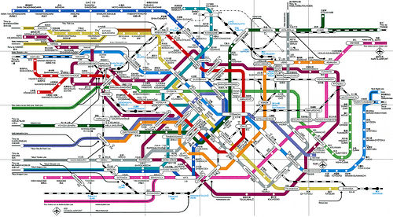
To create knowledge
Information must transit smoothly
openness and transparency
Information must transit smoothly
openness and transparency
Transit ‘distance’ short
optimal connections
Transit ‘distance’ short
optimal connections
Social networks determine transit ‘friction’ and distance
by Jeff Belmonte@flickr
by magnetbox@flickr
Notes:
(5 minutes) Knowledge and Wisdom require rapidly turning DIKW cycle. The transformation of information into knowledge is hampered if it cannot move easily between people. A large, poorly connected network will also slow transit. Humans have inherent abilities that can foster rapid transit times in communities. But, these inherent abilities are being overwhelmed by the results of modern technology. Luckily, we can leverage our technology to overcome this.

Slide 16
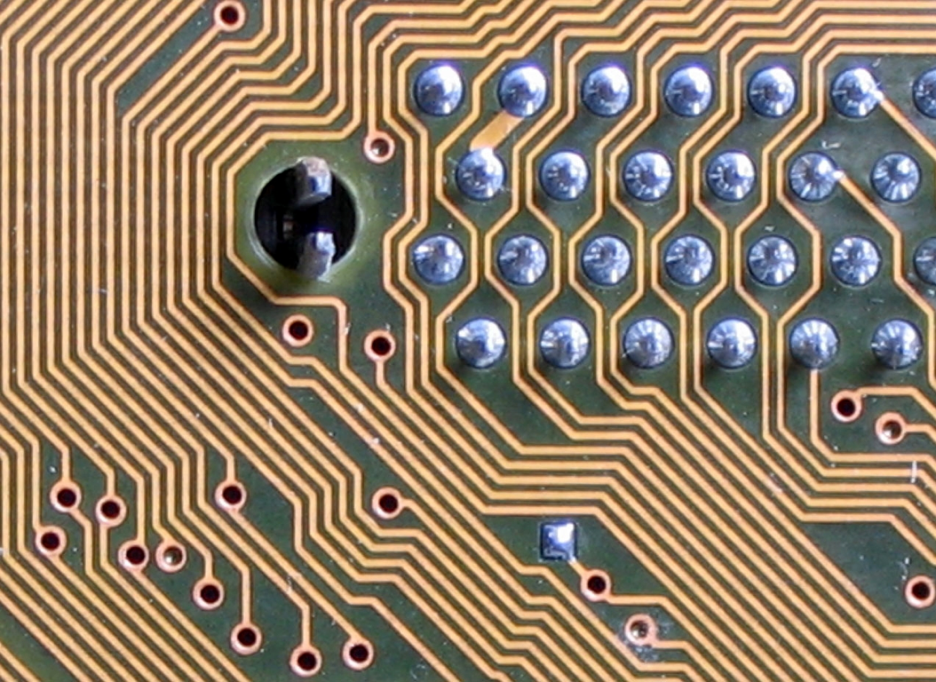
Understanding
by quapan@flickr
Notes:
So, moving into the future - any human endeavor that deals with data, information and knowledge needs a firm understanding of how human communities organize around these factors as well as how digital technologies will allow us to leverage this understanding in exponential ways. I’m a researcher so I love looking at data, transforming it into information which leads to a knowledgeable action. So let’s do some transforming right now. Let’s examine our inherent hierarchical structures – Team, Tribe and Town.

Slide 17
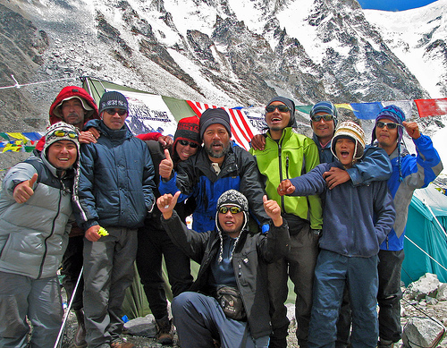
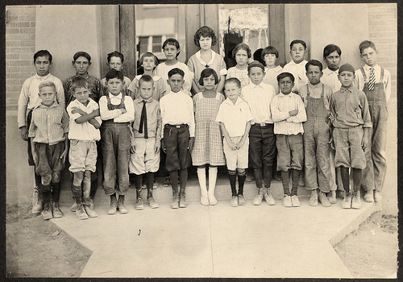
Key Numbers
100-150
30-50
9-15
Team
Tribe
Town
Notes:
Humans may be hardwired to work best in a series of three-fold hierarchies. Across the globe, the same hierarchical numbers pop up again and again. 9-15 is the size of a cohesive team which can focus on dealing with a simple problem. It is no wonder that most of the competitive sports teams in the world are approximately this size. The next step up the hierarchy is the tribe - about 3 times larger. This is the optimal size for multifunctional groups. There is enough cohesiveness for strength but enough diversity to deal with multiple problems. 150 is the hypothetical limit for our personal understanding of where we fit in a hierarchy. I will show just a little bit of the data illustrating each number.

Slide 18
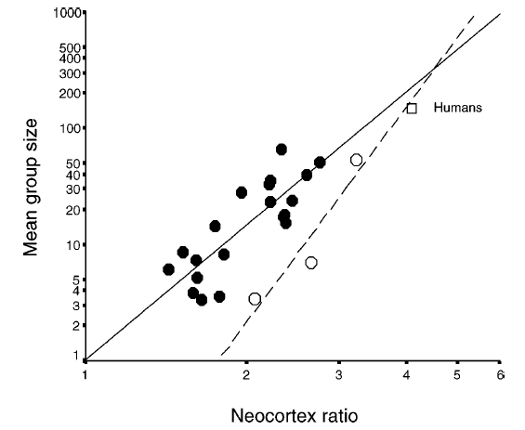
The Dunbar Number
Humans
Monkeys
Orang
Dunbar, Ann. Rev. Anthropol. 2003
Notes:
As I said, 150 is the maximum size of a social community that we can keep in our head. Robin Dunbar showed there was a linear relationship between the size of the primate’s brain and the size of their social group. Extrapolating to humans, he got about 150, plus or minus. Subsequent work has demonstrated the empirical power of this, especially in the collapse of cohesive organizational structure at sizes larger than this.

Slide 19
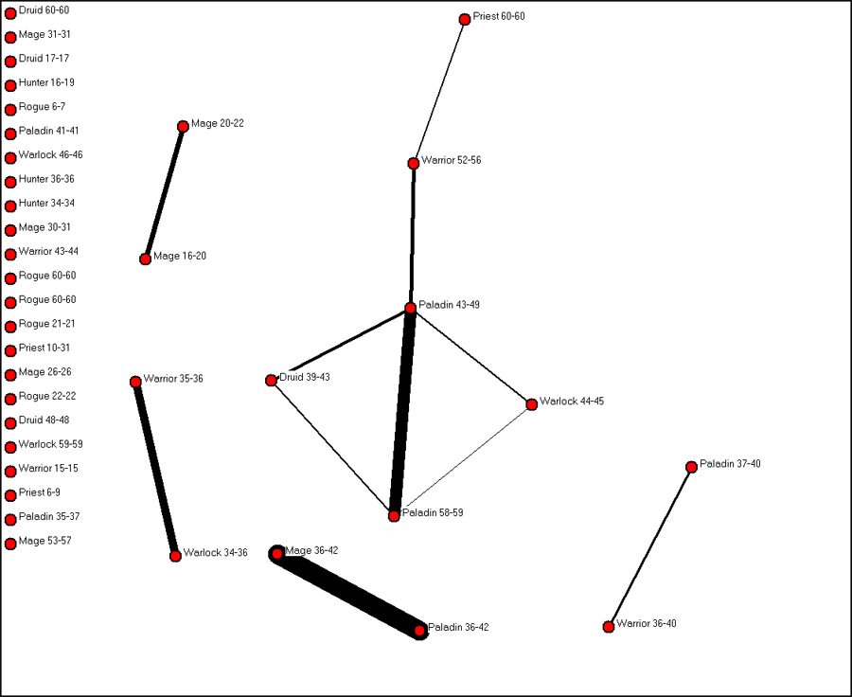
PARC
Social Network Analysis of
World of Warcraft
analysis based on 1 month observation of 5500 guilds
subgroups
cohesiveness
Notes:
Using modern tools to examine communities, the Palo Alto Research Center can help us see the other 2 numbers by looking at the online game - World of Warcraft. Here, individuals join together in guilds so they can more easily win quests, gain experience and dominate. PARC analyzed all the interactions between members in 5500 guilds over a month. They looked at which individuals in a guild played together, how often they played together and what was the maximum size of a cohesive group. In this example, 2 people play a lot with each other but they form a small part of a 6 member cohesive group (the max subgroup).

Slide 20
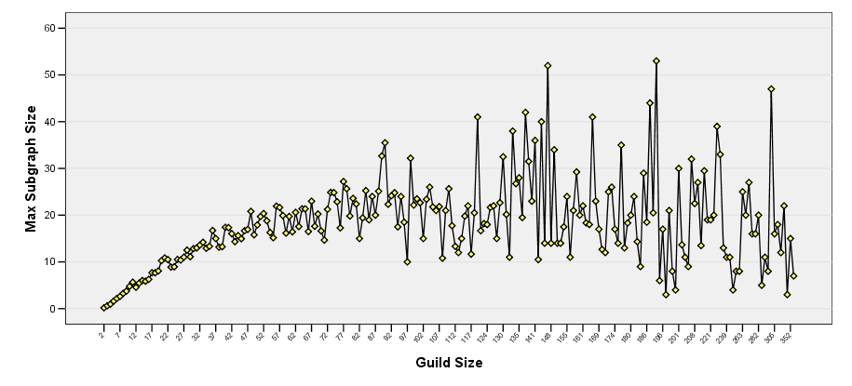
Cohesiveness in WOW Guilds
Increasing Guild size does not increase the size of most cohesive group
Increasing Guild size increases the size of most cohesive group?
50
15
Guild cohesiveness plateaus above ~50 members
Team cohesiveness trends to ~15 members
Notes:
Do people join together into larger communities to support larger cohesive sub-groups. Nope! There is a nice linear arrangement between max subgroup size and increasing guild size early on, we see that the max sub group size plateaus at a guild size of around 50 members with a sub-group of about 15. The magic numbers. After this, cohesiveness becomes random. The largest cohesive groups from some very large guilds are smaller than guilds with only 12 members. Why even belong? No one is working with anyone else. Some guilds are as efficient as smaller ones –having groups of 50 working together. How? Well, that is another grant proposal but using new tools allowed us to observe something hidden without them

Slide 21
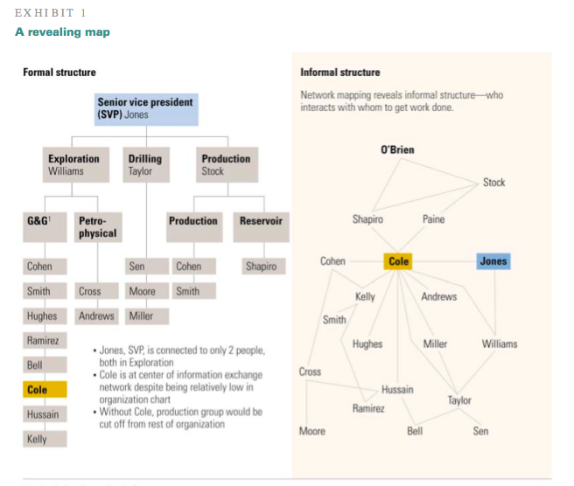
Hierarchy Not Enough
Hierarchies
Each layer increases complexity
Each step down knows less
Silos
Great for simple process
Bad for complex problems
Notes:
Built in hierarchies have been successful but, as we analyze increasingly complex processes, the DIKW cycle becomes hampered. Information flow slows as each level adds more people, silos appear, only the people at the top know what is going on and the rest of us no longer know where anyone fits in the hierarchy. Openness disappears. Information has to make a huge number of jumps to move around. We end up with limes all over again. But humans have evolved a second process, – Informal social networks. Someone can be insignificant in the hierarchy but occupy an important part of the informal social network. With them, information can route around the damage of hierarchies, and rapidly transit the organization.
----- Meeting Notes (11/15/13 11:40) -----
But humans have evolved a second process, – Informal social networks. Someone can be insignificant in the hierarchy but occupy an important part of the informal social network. With them, information can route around the damage of hierarchies, and rapidly transit the organization.

Slide 22
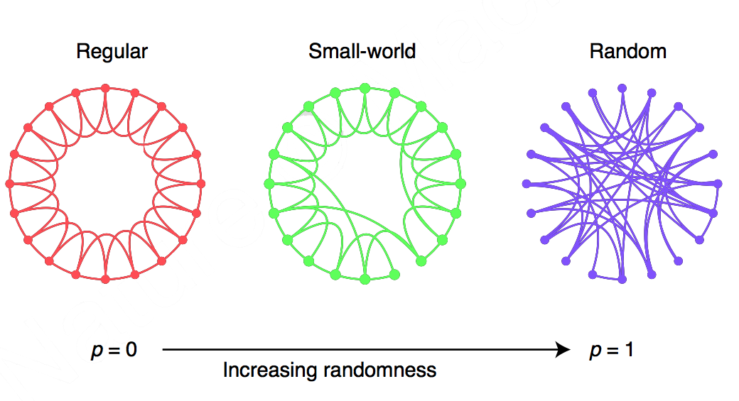
Networks
Watts & Strogatz, Nature 393, 440 (1998)
Notes:
(10 minutes)So lets look at how these informal social networks are put together. Networks can be regular - where you connect only to those close to you. It takes a lot of jumps to get to anyone. They can be completely random or they can be a mixture. These last are called small world networks

Slide 23
The power of small worlds
From Buchanan, Nexus based on the work of Watts & Strogatz, Nature 393, 440 (1998)
Connections | Random | Steps
50 (regular)
0
60 million
50 (small world)
1 in 5000
8
50 (small world)
1 in 3333
5
Notes:
In small world networks, the number of steps connecting people drops very rapidly. Say 6 billion people are evenly spread across a globe in a regular network and only connect to the 50 people closest to them. To connect to someone on the opposite side of the planet (3 billion people away), there would be 60 million steps. But if just one person in 5000 randomly connects to someone else, the number of steps drops to 8. 1 in 3333 drops this to 5 steps. A little of irregularity makes a small world network very efficient for moving information around because the transit distance of the network drops so rapidly.

Slide 24
Scale free networks
Remember High School?
Distance between nodes
Small diameter
Little change as nodes added
Loss of nodes
Robust
Little degradation at low levels
Notes:
Informal human social networks are a special type of small world called scale-free. Here, a newcomer has a higher probability of connecting to someone who is already highly connected. Like High School, some people are very popular, some are not. But the chaos of high school creates something amazing. First, the average number of jumps between people in a scale-free network is not much different if there are 10, 10,000, or 10,000,000 people in the network. Thus the number of jumps for information to transit the network remains small, even as the network grows exponentially in size. Loss of people has little overall effect on the ability for people to connect with others. Information can flow almost as rapidly within a large network as a small one and the loss of anyone is unlikely to hamper the robust flow of information.
----- Meeting Notes (11/15/13 11:39) -----
Loss of people has little overall effect on the ability for people to connect with others. Information can flow almost as rapidly within a large network as a small one and the loss of anyone is unlikely to hamper the robust flow of information.

Slide 25
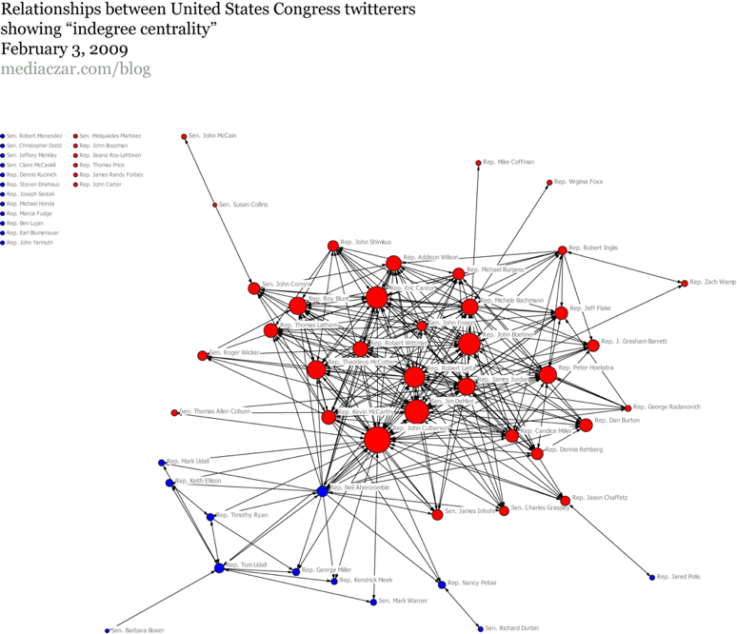
Congressional Twitterverse
Notes:
Let’s look at some real data to get an idea of how we can use our understanding to enhance information flow. This the twitterverse for members of Congress, showing how they connect to one another. It is from several years ago for simplicity’s sake. It is obviously not a well-constructed scale-free network. Red are the GOP and Blue are the democrats. The size of the circle represents the number of connections.

Slide 26
Notes:
Some of the names are pretty well known in the hierarchy– John Boehner, for example. You can see that the Democrats and the Republicans have very few points where information passes between them. The most important Representatives in the network, the biggest circle for each party, the ones who make sure that information flows well within and between groups – Abercrombie and Culbertson – are nobodies in the scheme of the hierarchy. But they are huge when it comes to information flow.

Slide 27
Notes:
Some of the names are pretty well known in the hierarchy– John Boehner, for example. You can see that the Democrats and the Republicans have very few points where information passes between them. The most important Representatives in the network, the biggest circle for each party, the ones who make sure that information flows well within and between groups – Abercrombie and Culbertson – are nobodies in the scheme of the hierarchy. But they are huge when it comes to information flow.

Slide 28
Congressional Twitterverse
Notes:
What happens to this network if it did not contain those two individuals?

Slide 29
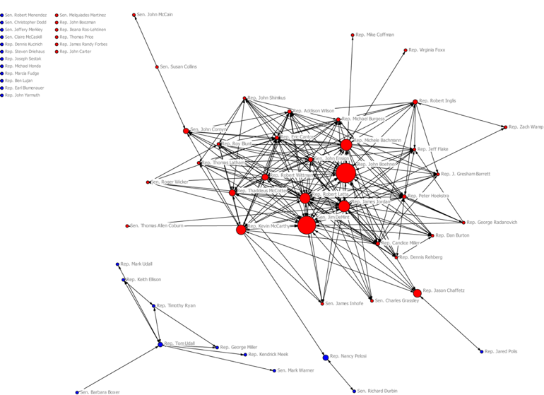
Removing Culberson (R) and Abercrombie (D)
Notes:
Take them away and information flow between these two groups collapses, as well as severely affecting flow within the group. With restricted information flow comes a restricted ability to achieve wisdom. Having information flow between major segments of an organization be dependent on just 2 people is crazy. If we really wanted Congress to solve complex problems, we should elect politicians who would work to create more robust connections, to come closer to an efficient scale-free network.

Slide 30
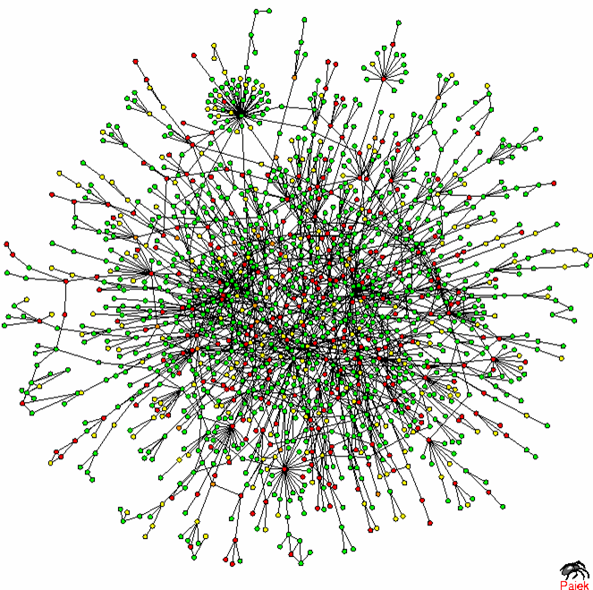
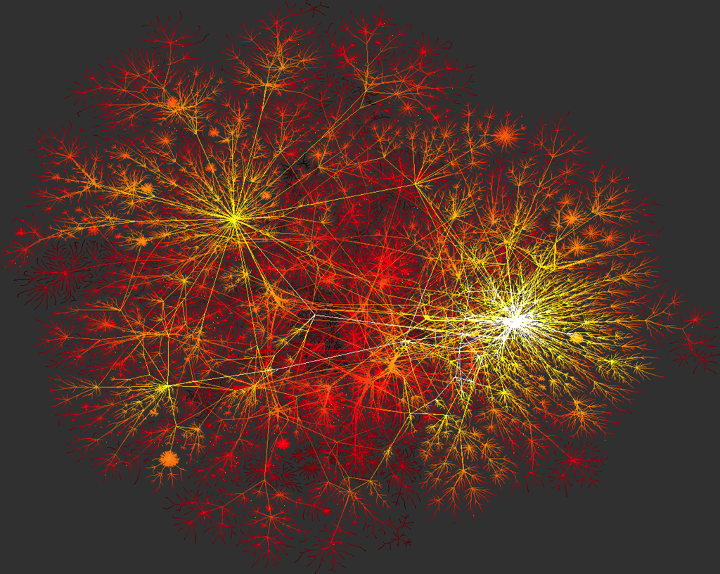
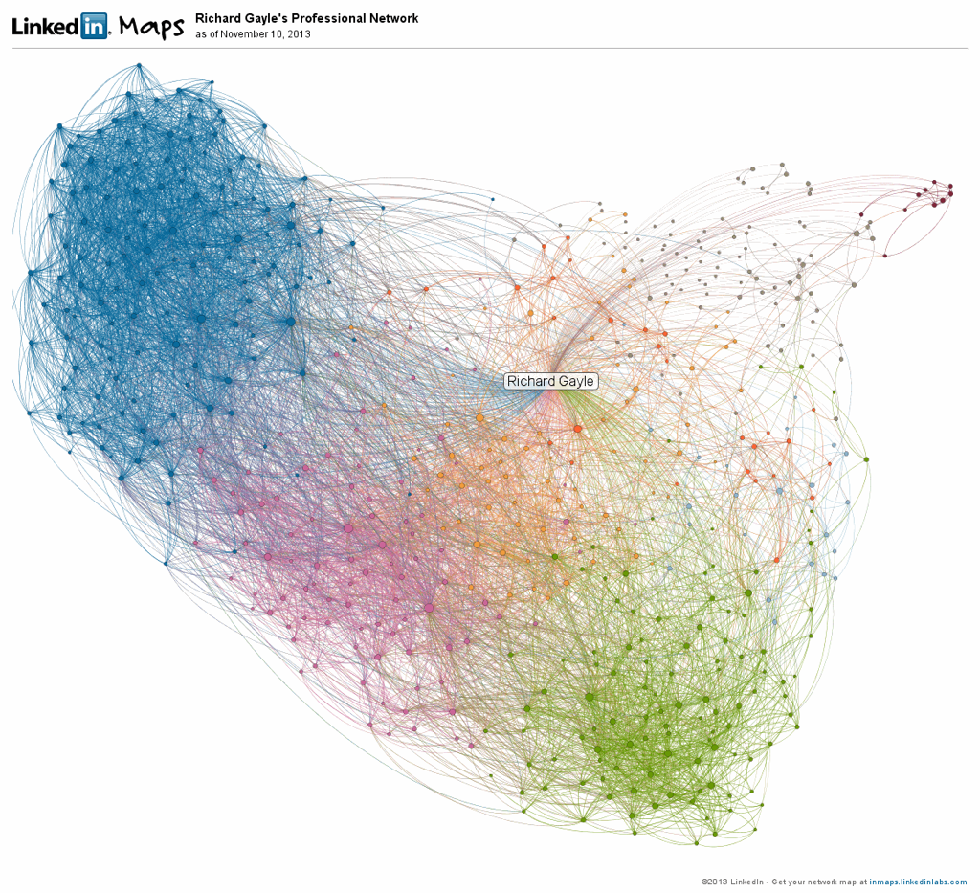
Proteins
Computers
People
Notes:
(13 minutes)Scale-free networks seem to pop up where large amounts of information must be moved around rapidly and robustly. Enlarging the network by adding more people means more data can be examined to produce the information needed. The scale-free nature of a well-constructed network means that this information can be easily transformed by collaboration into knowledge. And our tools allow us to use huge social networks. Here is my Linkedin network–558 people– way too many for me to possibly remember. But, I can easily see that I serve as a link between several important communities. I can also see important links into different communities.

Slide 31
Need to change
Hierarchies not as useful
Technology leverages social networks
Manage networks to increase flow
Enlarge the ‘scientific’ community
Notes:
“Where we have come from” is ever increasing flows of scientific information. “Where we are” is watching huge amounts of data, coupled with poorly constructed hierarchical networks, hampering the creation of knowledge and wisdom. “Where we go” will require us to better use the same technologies that are causing these problems. Digital technologies will not only allow easier information flow to communities of scientists, they will also allow us to create larger scale-free social networks that work efficiently, even as we enlarge the idea of who is a scientist by engaging multiple novel communities.

Slide 32
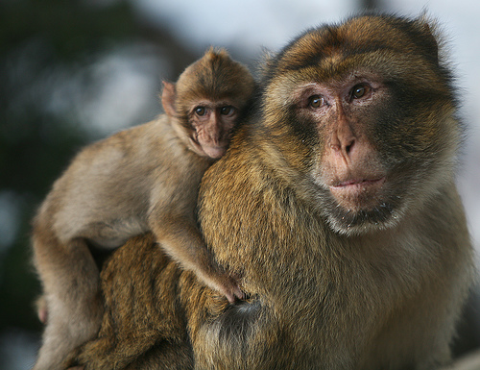
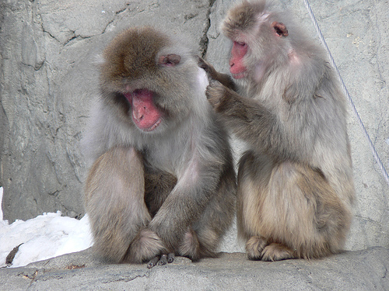
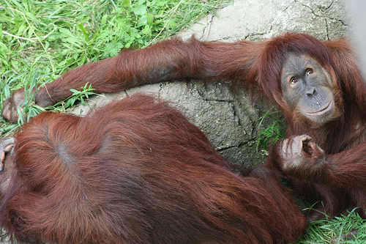
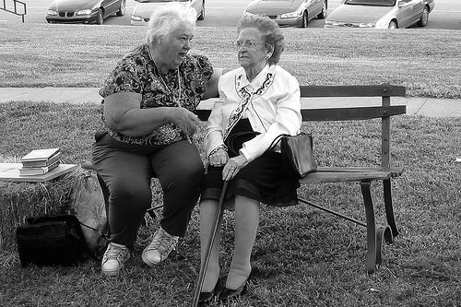
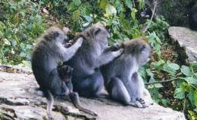
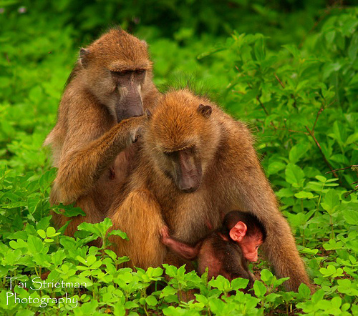
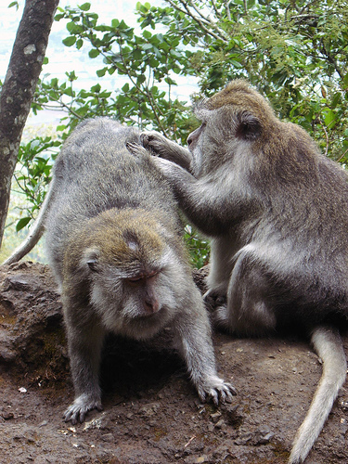
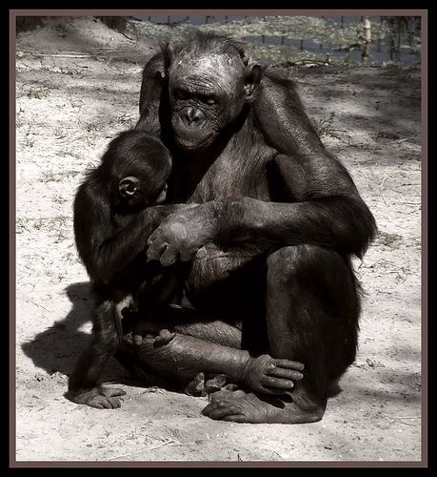
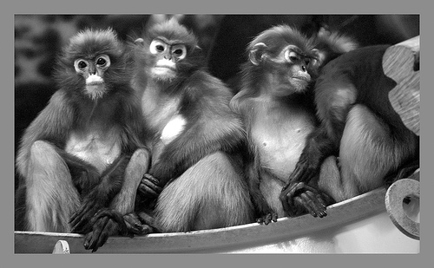
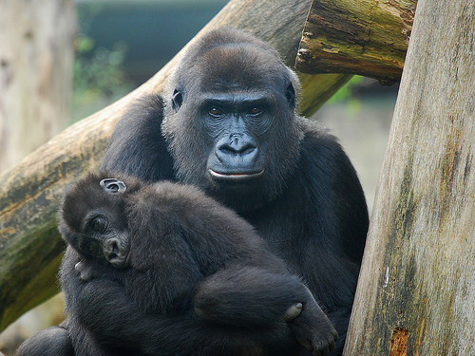
by karynsig@flickr
by Praziquante@flickrl
by Crystalline Radical@flickr
by stolte-sawa@flickr
by ercwttmn@flickr
by tai strietman@flickr
by mape_s@flickr
by downing.amanda@flickr
by digitalART2@flickr
by LarsVegas@flickr
Notes:
As primates, we have to communicate. We are social animals hardwired to transform information into knowledge and wisdom. We must attack the communications problems facing us by using new tools to create and enhance scientific communication processes. Communicating in ways that enhance information flow, permit knowledge to spread and foster wisdom will come to dominate.

Slide 33
Notes:
Thanks for listening to me. I hope some information was transformed into knowledge. Now let’s move onto the first talk this afternoon.

