Slide 1
Journal Pricing, Libraries and Access
nSCI Fall 2013 Conference:
Journals and Science
Tim Jewell
Director, Information Resources
And Scholarly Communication
UW Libraries

Slide 2
Cash vs. Non-cash costs Source: Research Information Network briefing on Activities, costs and funding flows in the scholarly communications system: key findings, 2008

Slide 3
Journal Economics and Market Size Source: STM Report, Nov. 2012
2011 STM info market: $23B
Journals, books, technical information and standards, databases, etc.
2011 STM journal revenues: $9.4B
Top 5 publishers:
35% of journals
Elsevier, Springer, Wiley: 2,000+ each
Non-profits (657 publishers?)
20% of journals

Slide 4
Journal access now digital Source: STM Report, Nov. 2012
Virtually all STM journals online
E-only subscriptions sharply up
Vast majority of use digital
2.5 billion annual downloads
Cost/download as low as $1(?)
Researchers: access good or very good
(but still want improvement)
Researchers use and cite more sources
But license language governs use

Slide 5
Journal article funding sources Source: Research Information Network briefing on Activities, costs and funding flows in the scholarly communications system: key findings, 2008

Slide 6
Who pays? Source: Professional Scholarly Publishing Bulletin, spring/summer 2013

Slide 7
Who pays? Source: Professional Scholarly Publishing Bulletin, spring/summer 2013

Slide 8
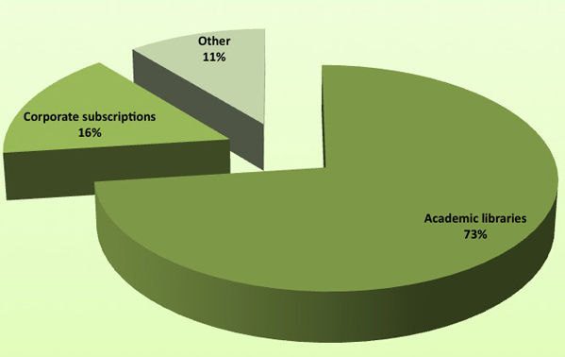
Where does the US$8 billion annual revenue for scholarly journals come from? Heather Morrison: Economics of scholarly communication in transition, First Monday, V. 8 no. 6 – 3 June 2013; Source: Research Information Network (2008)
Notes:
Heather Morrison:
Figure 1: Where does the US$ billion annual revenue for scholarly journals come from? Source: Research Information Network

Slide 9
What Libraries pay: Science journal pricing

Slide 10
Science journal prices vs. other fields

Slide 11
25 year average US journal price increases vs. CPI

Slide 12
2014 Pricing Projections Source: SWETS Serials Price Increase Report 2014

Slide 13
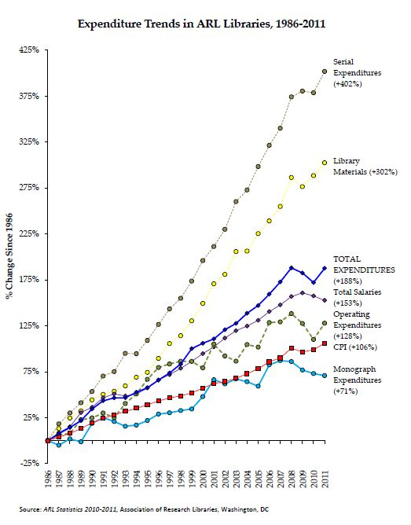

Slide 14
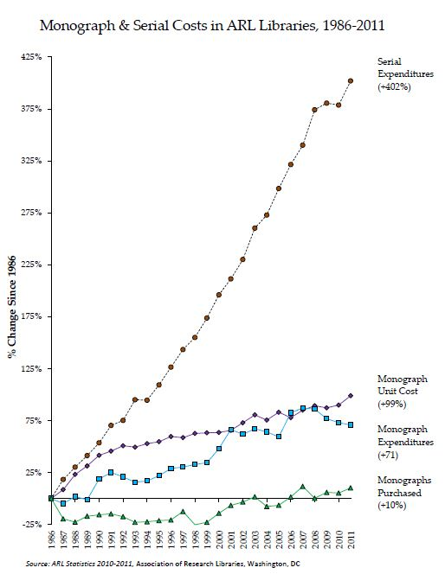

Slide 15
Non-profit vs. for-profit for selected science fields, 2013 Source: Journalprices.com summary data

Slide 16
“But nobody pays retail anymore” graph from Paula Gantz, “Digital Licenses Replace Print Prices as Accurate Reflection of Real Journal Costs,” Professional Scholarly Publishing Bull., v. 11 no. 3)

Slide 17
Publisher journal bundling basics
“Big deal” (all titles) or subset
Price based on past “spend”
Libraries get
Access to “unsubscribed” titles
Annual price increase caps
Libraries lose
Ability to cancel/reduce spend
Right to discuss (“nondisclosure”)

Slide 18
Bundling “Uptake” Source: Strieb & Blixrud: The State of the Large-Publisher Bundles in 2012

Slide 19
Bundling and Library Consortia Source: Strieb & Blixrud: The State of the Large-Publisher Bundles in 2012

Slide 20
More perspectives on bundling, costs and access
STM Report (2009):
unprecedented increase in access
“largely contributed to ending the serials crisis”
Andrew Odlyzko (2013 paper)
Big increase in access, but
E-access allows “price discrimination,” so more benefit for smaller libraries
Bosch and Henderson (LJ journal pricing article authors)
Not so fast – lies, damn lies, and . . .

Slide 21
Bundling and unbundling Source: Strieb & Blixrud: The State of the Large-Publisher Bundles in 2012

Slide 22
Bundling and disclosure Source: Strieb & Blixrud: The State of the Large-Publisher Bundles in 2012

Slide 23
A few tentative conclusions
Bundling has helped increase and democratize access for libraries
Journal price increases are unsustainable for libraries
Unbundling is inevitable
Independent researchers, small companies, the public are ill served by the prevailing arrangement

Slide 24
Open Access as the future?
Taxpayer access argument hard to refute
OA already deflating investment analysts’ publisher stock price projections
“More than enough money in library acquisitions budgets to fund an open access scholarly publishing system” (?)
Source: Heather Morrison, “Economics of scholarly communication in transition,” First Monday, Vol. 18, No. 6, 3 June 2013

Slide 25
Comments and Questions?
Tim Jewell
tjewell@uw.edu/206-543-3890

