Slide 1
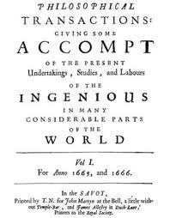

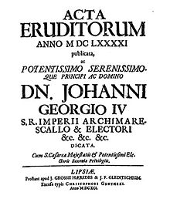
A Global Voice For Nature?
English and the
Scientific Journal
Scott L. Montgomery
Author, Affiliate Faculty
Jackson School of International Studies, UW

Slide 2
This Talk
How Global is English in Int’l Science?
Impacts: the Not-So-Good & the Good
Lingua Franca of the Past
What kind of scientific English?
Notes:
This talk will discuss:
How global has English become in international science. This means journals that aim at a multinational audience, international scientific meetings, and other venues, including websites, with the same audience in mind.
What impacts does a global language bring with it? There are both disadvantages and advantages, or what I have termed here the “not-so-good” and the “good.”
Is this global lingua franca role for English completely new, or might there be other languages that acted as something similar in the past? If there were, what might we learn from studying them?
Finally, we should consider what type of English is this global scientific tongue. Is it standardized? Does it follow the Anglo-American model? Moreover, how has this English evolved, say over the past half century or so? Is there any hope that it will become more comprehensible to the average reader in the future?

Slide 3
Globalizing by “Output”
STEM Papers: 1995 - 2009
Asia-8 = India, Indonesia, Malaysia, Philippines, Singapore, South Korea, Taiwan, Thailand; Asia-10 = Asia-8 plus China and Japan;
U.S. National Science Board, Science and Engineering Indicators 2012
Notes:
This is a graph from the National Science Foundation’s Science and Engineering Indicators Report, showing peer-reviewed research papers published in major international journals over a 20-year period, from 1995 to 2009, inclusive.
While there is a great deal of information here, perhaps the most important of all is often the most ignored—the Rest of World. But this means the vast
majority of countries around the globe, especially those of the developing world. We see that their publications have risen considerably, especially since year 2000.
These publications are in English. This graph, then, tells a story, the story of a rapidly globalizing language in international science. The story is far from over. Already, however, by 2009, users of English in science around the globe in non-English speaking countries far outnumber those in Anglophone nations.

Slide 4
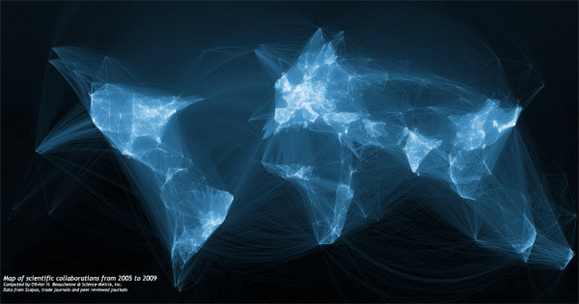
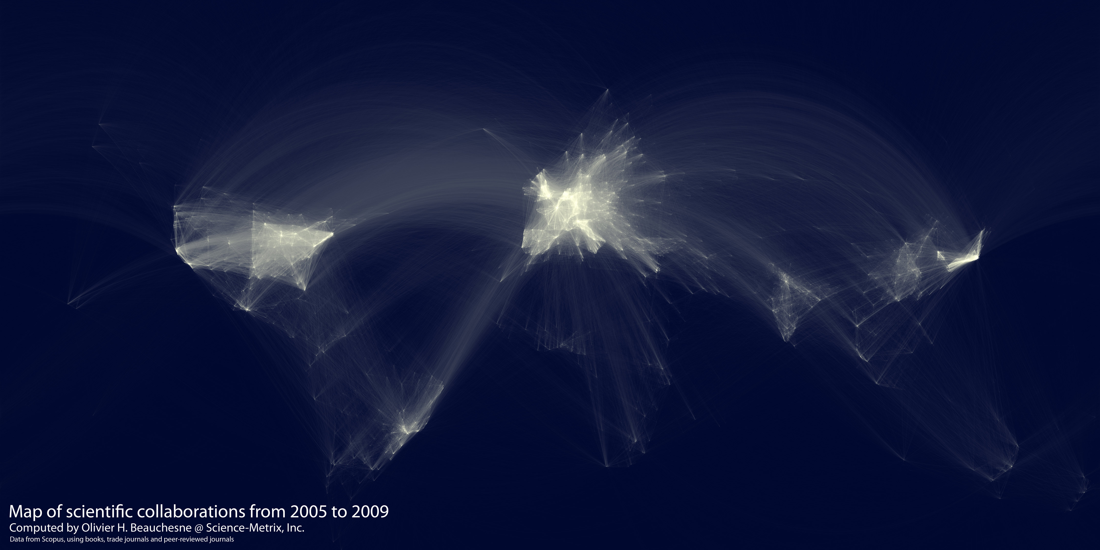
Research Collaborations 2005 - 2009
Notes:
There are other ways of showing the spread of English in science.
When we look at a map of international collaboration, determined by multinational co-authorship of peer-reviewed papers, we are made instantly aware that the Sun is quickly setting on the era when advanced scientific work was confined to a handful of western nations, plus Japan. There are a number of reasons for this, to be sure, but one of them is the reality of a global language—a language that not only permits, but encourages, even demands, such collaboration. Could we even say this is a map of English competence around the scientific world? Possibly. There is the strong possibility that a number of the collaborations involved only one or two members who were strong in English and who ended up writing most or all of the final published paper.
But what we can say, without any doubt, is that science today has spread far beyond the borders that contained it for most of its modern development—that is, the borders of western Europe, North America, Japan, and, to some degree, Russia. It is a new era for science, and it has only just begun.

Slide 5
Int’l collaboration for UK, non-EU
Int’l collaboration for UK, non-EU
2006 - 2011
International Comparative Performance of the UK Research Base – 2011; Dept. of Business, Innovation, and Skills. UK.gov
Notes:
Just taking the UK alone, and making a simple map of collaboration data for a recent 5-year period shows us how extensive multinational science has become.
Certainly there are political aspects to this. The end of the Cold War opened up a whole new era of globalization for science, and this globalization is greatly aided by a global language that allows researchers to share their work.

Slide 6
A Global Language: Good or Bad?
The Not-So-Good
  Bias against non-speakers
  Marginalization of scientists, languages
  Int’l invisibility of much good science
The Good
  Collaboration, interaction, sharing
  Mobility, opportunities for training & jobs
  All nations have access to best data
  = more good science by a global collegiate
Notes:
This new era for science, however, does not come without problems. It is essential to understand what these are, as well as their effects. What some sociolinguists have called “power languages”—lingua franca that are used over large areas, in many aspects of political and intellectual life—have always come with major impacts, both on people and other languages.
First among these impacts is bias against non-speakers; they can be considered to be less competent and backward, not part of the inner circle of advanced science.
This can lead to their marginalization, therefore. But this works as well for those whose ability in the power language is not strong. No matter how good they may be as researchers, they are unable to participate at the highest levels. This works for other languages, too, though in a different way. Over time, they are weakened as the bearers of scientific knowledge, as the lingua franca becomes the tongue in which new vocabulary is coined, for example. Other languages must then have speakers who borrow new terms or somehow translate them. Linguistically speaking, this isn’t a special circumstance at all. Indeed, English itself is largely a result of such borrowing, from a host of languages such as French, German, Spanish, Latin, Greek, and more. But today the incorporation of English words in other languages tends to create anxiety---a kind of political anxiety—that an original substance is being contaminated and will eventually be taken over.
Be that as it may, the worst impact of a global language is that its dominance in the international literature—above all, in scientific journals—leaves a great deal of excellent science in national tongues invisible, unknown to the greater international community. As a great deal of contemporary science does take place in national languages, this defines a significant problem.
What, then, about the brighter side, the advantages that a global language has for science.
First, as we’ve already seen, it greatly enhances collaboration and the opportunities for more and more interaction and sharing among scientists. This includes both formal and informal dimensions. As researchers well know, good ideas can often come out of conversations, whether at meetings, email exchanges, over dinner or drinks, after a lecture—in a great many situations where scientists communicate with one another.
Second, a global language opens up many new possibilities for researchers to be mobile, to work in other countries, for international companies, and to gain training abroad in nations with the most advanced facilities and best universities. Such is an enormous advantage, especially for those scientists in developing nations. This doesn’t mean a “brain drain,” but, as now understood, a “brain circulation,” though there is always some tension that exists between nationalism and internationalism in this context.
All of this equals, over time, more good science performed by a global collegiate of researchers. Science returns again to being a kind of world culture. Why do I say this?

Slide 7

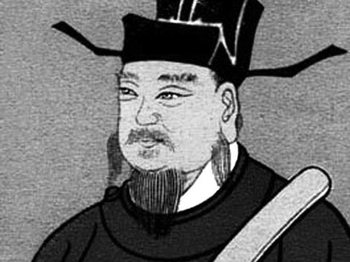
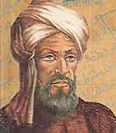
English not the first lingua franca of science
What can we learn from the past?
Notes:
Though this is a new era for science, it is not wholly without precedent. There have been other large-scale lingua franca of science in the past.

Slide 8
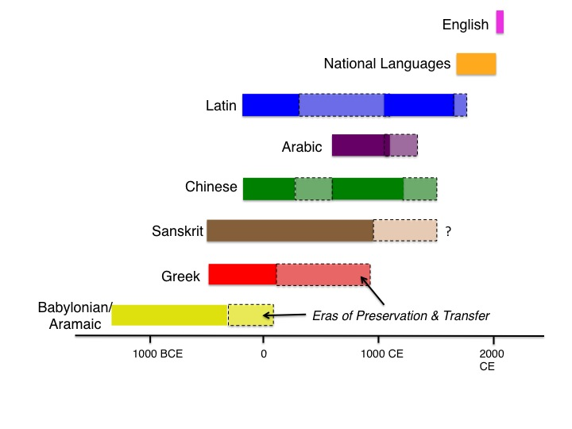
Notes:
This is a chronological chart that plots most of the major lingua franca of science in its most advanced forms over the past several thousand years.
It is intended to show only a few aspects, mainly:
The length of time each language was actively being used to advance scientific knowledge, broadly considered.
Those periods when such activity shifted to a more preservative function—meaning, when major additions to scientific knowledge had stopped, but texts remaining from times of advance were being preserved in some form, including translation into other languages.
It also indicates that, following the demise of Latin as a lingua franca there occurred a period of about 300 years when no great lingua franca existed. Instead, scientific advance tended to occur most often in national languages, above all those of western Europe. This period includes most of the modern era, from the late 1600s up until the 1980s, at which point English begins to take over as a global language for science.
The chart is simplified, of course. French was a widely used lingua franca in Europe during the 18th century, as was German in a number of scientific fields between the 1870s and 1920s. Yet in both cases, more scientific work overall was performed and published in other national tongues.

Slide 9
Patterns, Themes
Major lingua franca last a long time!
Their status marginalizes other tongues & obligates scholars to learn them
They act as nourishment for scientific advance (minds from varied cultures)
Notes:
From this plot, however, we learn several important things:
Lingua franca have routinely lasted for centuries, often greatly outliving the empires that put them in place.
They are languages of power and status, and this means their use ends up marginalizing other tongues for science; scholars have been obligated to learn such a language of knowledge and status.
The greatest eras of scientific advance—ancient Mesopotamia, classical Greece, ancient and medieval India and China, Renaissance Europe, have taken place when such lingua franca were in place. This suggests—and, indeed, it is not difficult to prove this using historical evidence—that such languages have acted as essential nourishment for scientific work again and again. The Scientific Revolution, too, got its start in the 16th century (Copernicus, Vesalius, Kepler, William Gilbert, etc.) when Latin was still firmly in place.
Finally, we see that the global role of English as the next great lingua franca for science has just begun. We are only in its beginning stages.
Now, there are those who doubt that this new era will last very long. English will prove the « last lingua franca, » as one linguist has claimed. The reason: automatic (computer-driven) translation, or, as it’s known more officially: Machine Translation (MT). However, there are several problems with this idea.

Slide 10


Notes:
It is an ancient dream that technology will one day solve all problems that arise with a difficult human dimension to them. This includes communication.
But it is a dream. Our fantasies of universal translators always arrive with human beings inside them, like 3CPO.
Most experts in MT will admit that the future capabilities of computer translation remain very uncertain, especially when it comes to complex material that requires a great deal of knowledge to understand, to tell the difference (for example), between a savings bank, a river bank, a blood bank, and a data bank.

Slide 11
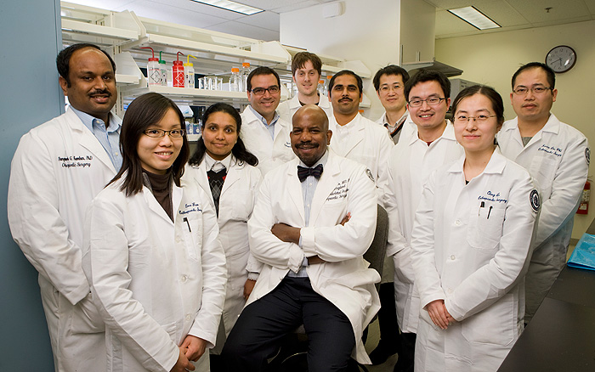
Notes:
For a research team that works well together, and feels comfortable enough to stand this closely, computer translation would not work well.
It is face to face language that brings these people together, as researchers and as people. No universal translator can do this.
Taking the human dimension out of language is a vain enterprise, for it reduces contact, not expands it.
We see, in other words, that a perfect universal translator would be an attempt to end all learning of foreign languages.
Certainly, though, the learning of English can be difficult…

Slide 12
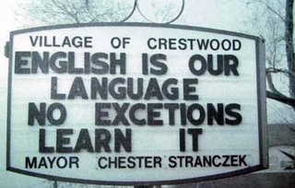
Notes:
…even for some native speakers…

Slide 13
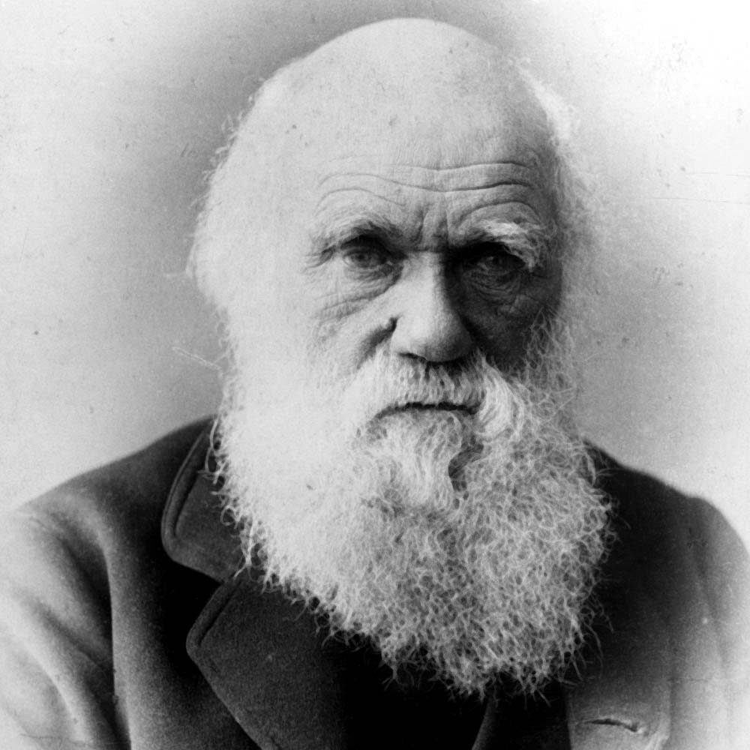
What kind of scientific English do we have today?
A Brief Empirical Look
Notes:
So, for scientists interested in sharing their work with the greater global community, this brings up a question.
What does scientific English look like today? Indeed, how has it evolved over the past half-century or so?
A response to the second question will lead us to an answer for the first query. What follows, then, is a brief empirical look at scientific English in one field, geology, as expressed in one high status international journal.

Slide 14
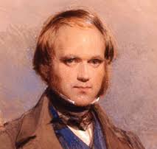
Evolution of a Discourse
Geological Society of America Bulletin – March, 1955
“The importance of fractures can hardly be exaggerated. Most likely, man could not live if rocks were not fractured. The loosening of rocks, formation of soil, and erosion would become next to impossible…”
Ernst Cloos: “Experimental Analysis of Fracture Patterns”
Notes:
Here is a first sample, from the Bulletin of the Geological Society of America, from March 1955.

Slide 15
Evolution - continued
March, 1985
“The breakdown of rocks by freezing, or frost cracking, has been a subject of great interest to geomorphologists for many years. Frost action has been considered to be of paramount importance in the development of landscapes…(Refs)”
Joseph Walder and Bernard Hallet, “A theoretical model of the fracture of rock during freezing”
Notes:
Our second example, from the same journal and same month, comes 30 years later.
A single point to make—among many others—is how the total potential audience addressed has been reduced from all of humanity (in the first example) to geomorphologists, who represent a single branch of the geological sciences.

Slide 16
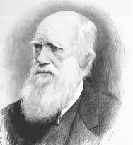
New species of discourse?
September, 2013
“The shape and growth of the frontal wedge of modern accretionary complexes repeatedly change to maintain the dynamic equilibrium in the wedge through alternating tectonic and sedimentary (i.e., gravitational) activities (9 Refs).”
Andrea Festa, Vildirim Dilek, Guilia Codegone, Simona Cavgna, and Gian Pini,
“Structural Anatomy of the Ligurian accretionary wedge, and evolution of superposed mélanges”
Notes:
Here, then is our third example, this time 28 years later, as we haven’t arrived at 2015 yet.
In this case, I would draw your attention to two things in particular, again among many others that could be discussed. First, the specialized vocabulary (jargon, we might say) of the first two lines determines instantly who may enter here and who would be wasting their time in an attempt to do so. If you don’t know what the wedge of an accretionary complex is, you are not welcome here.
But also note the authorship of this article. It is fully international. Affiliations of the authors include universities in Italy, Spain, and China. The journal, in other words, may be named the Geological Society of America Bulletin, but it is fully global in the span of its contributors and their subjects.

Slide 17
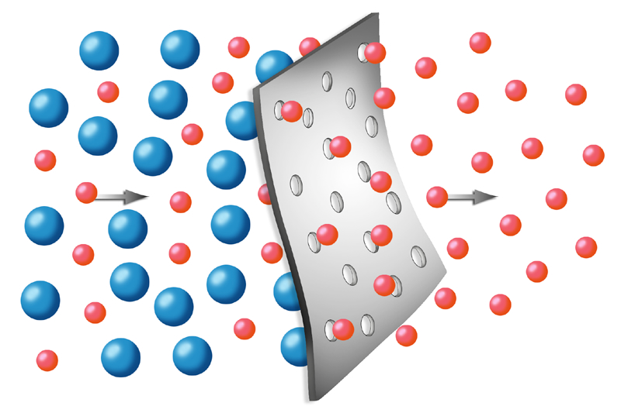
Historical Result
More stylized, formal, jargon-dependent
Little chance that journal science will become more accessible to the public
Science needs translators!
Notes:
So to summarize the trends in these three samples, as indicative of scientific discourse as a whole—and I would wager that an overwhelming majority of researchers would agree to this—we see that this discourse has become progressively:
--more stylized, specialist
--less open to the kind of relaxed, colloquial, and literary touches seen in the first example.
--greatly dependent on jargon to carry the weight of meaning.
Given these trends, it would appear there is but little chance that journal science will become more accessible to the public, or even to scientists from other fields.
What all this tells us, finally, is that the transfer of findings from the journal literature to the public involves not just re-phrasing and selection, but an act of actual translation—remembering that translation always involves interpretation and re-writing. People able to do this competently, without inaccuracies or misleading exaggerations, can not be found at your local market or grocery store. Nor do a great many of them exist in media centers. They are rare and their value should be recognized.

Slide 18
A New Phenomenon – Rhetorical Flexibility
“Seismicity of Egypt is attributed to the relative tectonic motion between African, Arabian, and Eurasian plates…The identification of active fault planes in these seismogenic zones is essential for the potential seismic hazard that may carry on the closed urban cities.”
A.K. Abdel-Fattah, K.Y. Kim, M.S. Fnais (Saudi Arabia, Egypt, South Korea)
“Slip distribution model of two small-sized inland earthquakes and its tectonic implication in north-eastern desert of Egypt”; Journal of African Earth Sciences
Notes:
Now, I’d like to show you one final phenomenon along these lines, something which is very new.
In this final passage, we see something quite different than what we’ve been discussing. Most of the passage is in perfect good, comprehensible English. But then we encounter the final few phrases, which leave us puzzling. How did this get past the editors? In fact, the journal’s editors include geoscientists from the U.S. and other Anglophone nations.
The fact is that a sizeable number of journals have begun to publish articles with non-standard English—meaning non-Anglo-American (the standard most widely adopted and followed by the highest prestige journals like Nature and Science). The degree to which this might expand in the future is difficult to discern. The reality of World Englishes, meaning varieties of English that have developed around the world through adaptation to different cultural-linguistic settings (e.g. Nigerian English, Honk Kong English, Jamaican English, Indian English, etc.) may well dictate that such flexibility will have to grow. We will have to wait and see.
One final note here—consider, again, the authorship of this article.

Slide 19
Notes:
We might, then, think of our research team once again. The English language is their language, too, their language of knowledge. However they decide to use it—to obey the Anglo-American standard or not—it is still their language, no less than it is mine, or yours. It may already be true that there are a greater number of scientists who communicate in English than those who grew up with the language as their mother tongue. If this is not the case today, it will be tomorrow. The other side to a global language is that, in the end, it belongs to everyone and, with regard to control of it, to no one.

Slide 20
Thank you!
scottlm@uw.edu

