Slide 1
How Journal Articles Are Ground Into Digestible News
My Life as a Sausage Maker
Bryn Nelson, PhD
Photo credit: Laszlo Szalai via Wikipedia

Slide 2
Scientific Journal:
“Duodenal infusion of donor feces for recurrent Clostridium difficile”
(Source: N Engl J Med. 2013 Jan 31;368(5):407-15.)
Popular Press:
“From me, to poo, to you: The faecal transplants fighting C. difficile”
(Source: Metro UK; Feb. 12, 2013)
Example #1: The Good

Slide 3
Scientific Journal:
“Glycemic instability and spontaneous energy intake: association with knowledge-based work”
(Source: Psychosom. Med. 2008 Sep;70(7):797-804)
Popular Press:
“Thinking can make you fat, study shows”
(Source: The Telegraph. Sep 11, 2008)
Example #2: The Bad

Slide 4
Scientific Journal:
“Cured meat, vegetables, and bean-curd foods in relation to childhood acute leukemia risk: a population based case-control study”
(Source: BMC Cancer. 2009 Jan 13;9:15)
Popular Press:
“Bacon ‘gives kids cancer’”
(Source: UK Daily Mirror. Jan. 31, 2009)
Example #3: The Ugly

Slide 5
The Embargo
☑
Photo credit: Laszlo Szalai via Wikipedia

Slide 6
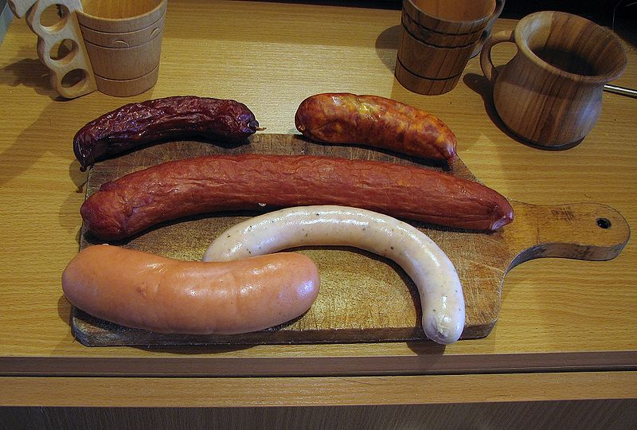
Journals: >30K
Newspaper
journalists: <40K
The Newsroom: Capacity for a few select journals only
⬇
⬇
Photo credit: Mariuszjbie via Wikipedia

Slide 7
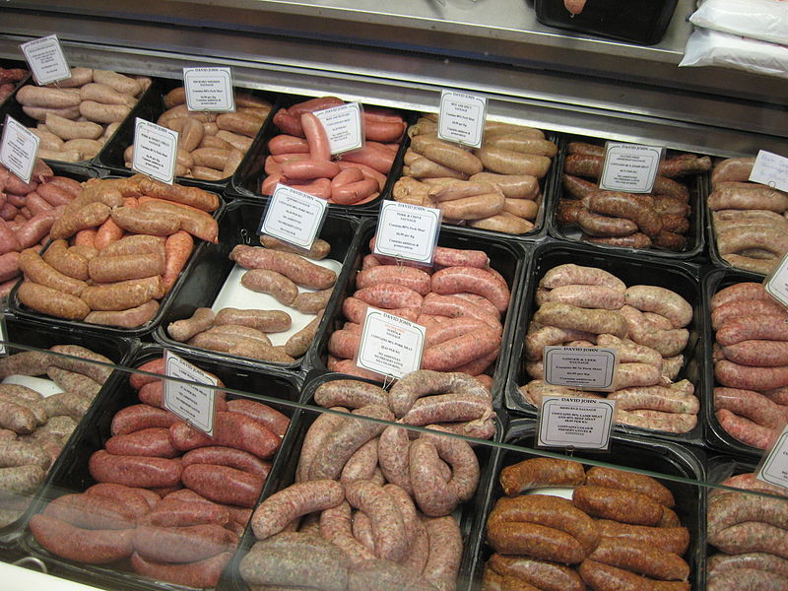
The Freelancer: Diversity is good
Photo credit: Kaihsu Tai via Wikipedia

Slide 8
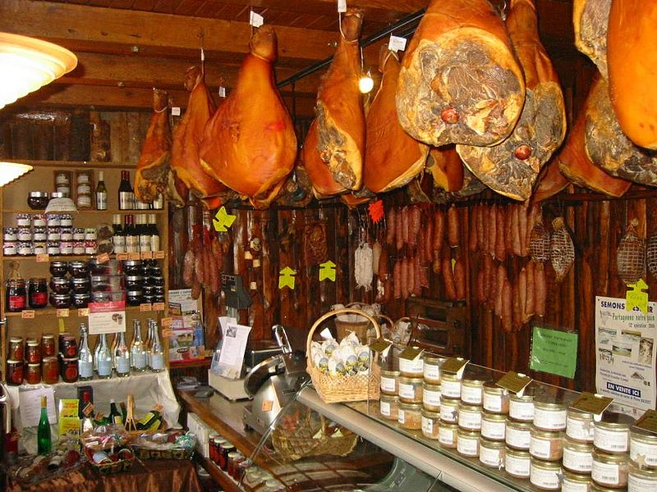
The Journal as Charcuterie: One-stop shopping
Photo credit: Arnaud 25 via Wikipedia

Slide 9
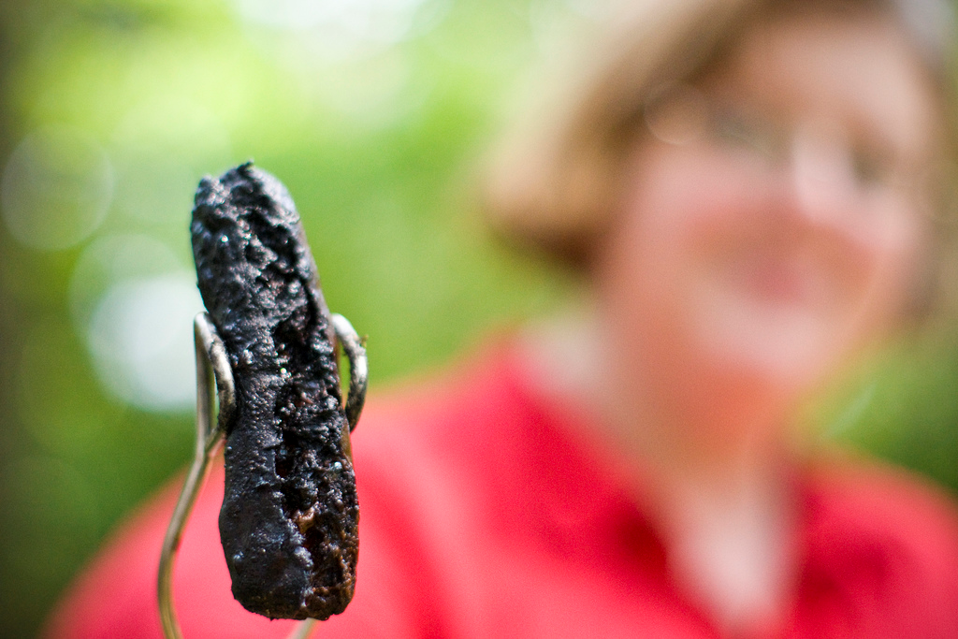
Quality Control: Sometimes it’s a little overdone
Photo credit: AbbyLadyBug via Flickr

Slide 10
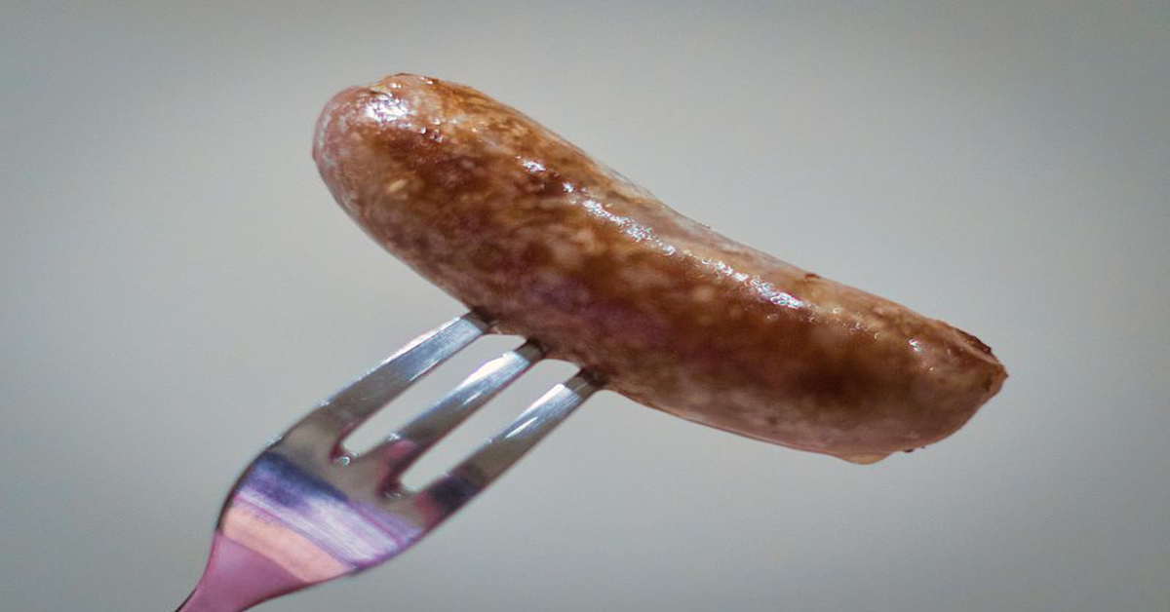
Bryn Nelson, PhD bdnelson@nasw.org www.brynnelson.com @SeattleBryn
Bon Appetit!
Photo credit: Alexbrn via Wikipedia

