Slide 1
Some Reflections on Forty Years of Interactions with Scientific Journals
Ross L. Prentice, PhD
Division of Public Health Sciences, Fred Hutchinson Cancer Research Center
and Department of Biostatistics, University of Washington
My research foci, and listing of journals since 2002
Women’s Health Initiative Clinical Trial and Cohort Study
Postmenopausal hormone therapy randomized, controlled trial findings, and related journal and media interactions
Low-fat eating pattern randomized, controlled trial findings and related journal and media interactions
Logistics of author-journal interactions – some time trends

Slide 2
My Involvement with Scientific Journals: 1970 – Present
Types of Journals:
Biostatistics / Statistics / Mathematics (1970⁺)
Epidemiology (1972⁺)
Medicine / Clinical Trials (1972⁺)
Disease Prevention / Public Health (1983⁺)
Women’s Health (1983⁺)
Nutrition and Chronic Disease (1987⁺)
Genomics / Translation (2003⁺)
Investigator-initiated vs. collaborative
Methodology vs. applications
Target audience: researchers who work in similar areas; broader biomedical research community
Disease prevention vs. disease treatment
Implications for policy (regulations; recommendations)?

Slide 3
Publications 2002⁺ in which I have been an author:
Biostatistics / Mathematics | Epidemiology / Public Health | Medical / Clinical | Nutrition | Genomics / Translation
Biometrics (4) | Am J Epidemiol (16) | JAMA (14) | Am J Clin Nutr (4) | Genome Med (5)
Biostatistics (4) | CEBP (8) | JNCI (12) | J Nutr (2) | Hum Genet (2)
Biometrika (3) | Genet Epi (2) | NEJM (6) | JADA | Nat Genet
J Am Stat Assoc (3) | Epidemiology (2) | Arch Intern Med (2) | Public Health Nutr | Am J Hum Genet
Lifetime Data Anal (3) | Ann Epidemiol (2) | Cancer Res (2) | Br J Nutr | Exp Neurology
Stat Med (2) | Ca Prev Res (2) | Menopause (2) |  | Adv Exp Med Biol
Clin Trials | Int J Epidemiol | Lancet |  | Card Circ Genet
Stat Biosciences | Cancer Causes Control | JAGS |  | BMC Genetics
Stat Sinica | Am J Public Health | Breast Cancer Res Treat |  | Obesity
Can J Stat |  | Osteoporos Int |  | Proteomics Clin Appn
 |  | Circulation
 |  | Diabetes
 |  | Hypertension
 |  | The Breast
 |  | BMC Cancer
 |  | Gastroenterology
 |  | Curr Atheroscler Res

Slide 4
Some Observations on Journals and Researchers
Wide variety of journals and niches
Scientists need journals: research unpublished = research not done
Publication in respected journals is key to career progress (research grants; promotions)
Journal status within disciplines is well known by researchers; limited impact from journal proliferation
Major medical journals have a substantial role in determining the message that practitioners and general public receive
Reliable scientific journal sources help to offset cacophony when treatment options have large business implications or when public health messages lack a sufficient evidence base
Some illustrations from the Women’s Health Initiative…

Slide 5
Design of WHI
os

Slide 6
WHI announced by NIH Director Bernedine Healy (1992) as a trans-NIH initiative.
Contract for Clinical Coordinating Center (CCC) in 1992 and for the initial 16 of 40 Clinical Centers in 1993
IOM Review in 1994
WHI allowed to proceed; program office moved to NHLBI

Slide 7
Women’s Health Initiative Clinical Centers
Fred Hutchinson Cancer
Research Center
Univ. of Minnesota Med. Ctr.
Kaiser Foundation
Research Institute
Medical College
of Wisconsin
Univ. of Wisconsin
SUNY
Buffalo
Univ. of Mass
Med. Ctr.
Univ. of Iowa
Wayne State Univ.
Albert Einstein
Col. of Med.
Brigham & Women’s Hosp.
Rush-Presb.
St. Luke’s
Med. Ctr.
Northwestern
Univ.
Univ. of Pittsburgh
Mem. Hosp. of Rhode Is.
Univ. of California, Davis
SUNY, Stony Brook
Univ. of Nevada, Reno
Ohio State Univ.
Univ. of Med. & Dent.
of New Jersey
Kaiser Foundation Research Institute
Univ. of Cincinnati
Medical Center
Leland Stanford Junior University
Medlantic Res. Inst./Howard Univ.
George Washington Univ.
Univ. of California, Los Angeles
Wake Forest University
Univ. of California, Irvine
Univ. of Tennessee
Univ. of North Carolina
Harbor-UCLA Research & Education Inst.
Univ. of California, San Diego
Emory Univ. Sch. of Medicine
Univ. of Arizona at Tucson
Univ. of Alabama
Univ. of Texas Health
Science Ctr., San Antonio
Baylor College of Medicine
Univ. of Florida
Univ. of Miami
Univ. of Hawaii

Slide 8
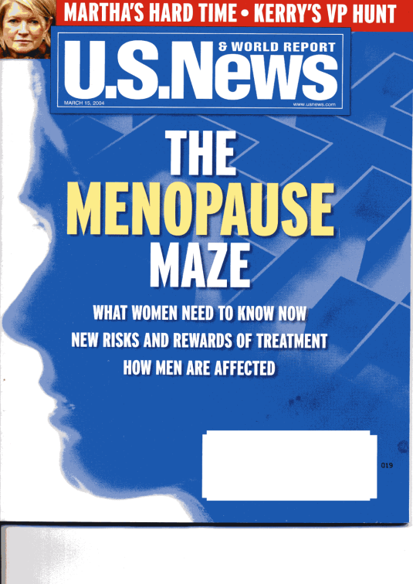
Intervention Phase (1993 – 2005)
E+P trial stopped early (2002)
E-alone trial stopped early (2004)
DM and CaD interventions concluded at planned termination (2005)

Slide 9
Clinical Outcomes in the WHI Postmenopausal Hormone Therapy Trials
(WHI Study Group, JAMA 2002; Anderson et al, JAMA 2004)

Slide 10
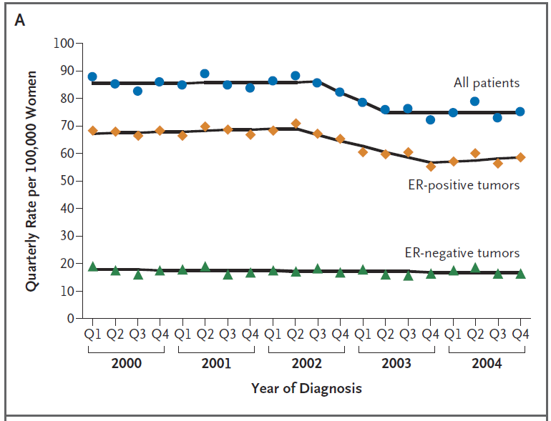
Quarterly Incidence of Breast Cancer in Women between the Ages of 50 and 69 Years, According to Estrogen-Receptor (ER) Status (2000-2004)
Data are from the NCI’s SEER registries.
(Ravdin et al, NEJM, 2007)

Slide 11
Low-Fat Dietary Pattern Trial: Findings and Methodology
Intervention Group Goals:
20% energy from fat
5 or more fruit and vegetable servings daily
6 or more grain servings daily
Photos courtesy of USDA Agricultural Research Service

Slide 12
Comparison of Cancer Incidence Rates between Intervention and Comparison Groups in the Women’s Health Initiative (WHI) Dietary Modification Trial*
Prentice et al (JAMA, 2006; JNCI, 2007); Beresford et al (JAMA, 2006)
Incidence per 1000 person-years
 | ( Number of cases) _______________________________
Cancer Site | Intervention | Comparison | p† | HR(95% CI)‡
Breast | 4.15 (655) | 4.52 (1072) | .09 | 0.91 (0.83 to 1.01)
Colorectal | 1.27 (201) | 1.18 (279) | .29 | 1.08 (0.90 to 1.29)
Ovary | 0.36 (57) | 0.43 (103) | .03 | 0.83 (0.60 to 1.14)
Endometrium | 0.79 (125) | 0.71 (170) | .18 | 1.11 (0.88 to 1.40
All other sites | 4.56 (720) | 4.81 (1140) | .30 | 0.95 (0.86 to 1.04)
Total cancer | 10.69 (1687) | 11.22 (2661) | .10 | 0.95 (0.89 to 1.01)
*Trial includes 19,541 women in the intervention group and 29,294 women in the comparison group.
†Weighted log-rank test (two-sided) stratified by age (5-year categories) and randomization status in the WHI hormone therapy trial. Weights increase linearly from zero at random assignment to a maximum of 1.0 at 10 years.
‡HR= hazard ratio; CI =confidence interval, from a proportional hazards model stratified by age (5-year categories), and randomization status in the WHI hormone therapy trial.

Slide 13
Low-Fat Dietary Pattern Intervention Effects on Breast and Ovarian Cancer, in Relation to Baseline 4-Day Food Record % of Energy from Fat
% of Energy from Fat | Mean (SD) Difference | Hazard Ratio | Interaction
(4DFR) | Between Groups | (95% CI) | P-Value
Breast Cancer (1727 cases)
< 27.9 | 9.7 (6.2) | 0.97 (0.79, 1.20)
27.9 - 32.3 | 10.4 (6.5) | 1.08 (0.89, 1.30) | 0.04
32.3 - 36.8 | 11.7 (6.6) | 0.85 (0.70, 1.03)
≥ 36.8 | 12.2 (7.0) | 0.78 (0.64, 0.95)
Ovary Cancer (160 cases)
< 28.7 |  | 1.33 (0.76, 2.33)
28.7 - 35.1 |  | 0.60 (0.32, 1.12) | 0.05
≥ 35.1 |  | 0.58 (0.31, 1.08)

Slide 14
Journal and Authorship Changes over the Decades
Proliferation of journals; competing communication outlets; open access; expectation of data availability
Formalized and augmented authorship requirements:
Disclosures
Word count restrictions
Page charges
High-dimensional authorship:
Big data
Meta-analyses among research groups
Authorship devaluation

Slide 15
Summary
My experience with scientific journals has been positive overall.
Considerable fairness, with an appropriate emphasis on interests of readership
Also considerable randomness in review/editorial process
Journals have a very substantial role in the overall biomedical research enterprise, in the careers of research scientists, and in the communication of findings to practitioners and the general public.

