Slide 1
How does publishing affect tenure? How is this relationship changing?
Robert Wood
Associate Professor, Atmospheric Sciences, UW
President, AAUP UW Chapter

Slide 2
Brief history of science publishing and tenure
1600s
Letters between natural philosophers.
The “Invisible Colleges” (informal networks of proto-scientists with common interests)
Book publications
1660-1670
First scholarly societies (Royal Society, French Academy of Sciences)
Philosophical Transactions of the Royal Society (1665)
1901-1915
Harvard, Columbia and Chicago make it clear that donors can no longer dictate faculty decisions
AAUP initial declaration of principles of academic freedom and tenure

Slide 3
Academic freedom and tenure
Academic freedom: “Teachers are entitled to full freedom in research and in the publication of the results” It is the indispensable quality of institutions of higher education. As the AAUP's core policy statement argues, "institutions of higher education are conducted for the common good and not to further the interest of either the individual teacher or the institution as a whole. The common good depends upon the free search for truth and its free exposition"
[from 1940 AAUP Statement of Principles on Academic Freedom and Tenure]
Tenure is the right of a faculty member to hold his or her position, and not to suffer loss of such position, or discriminatory reduction of salary, except for the reasons and in the manner provided in the Faculty Code.
    [from the UW Faculty Code, 25-31]

Slide 4
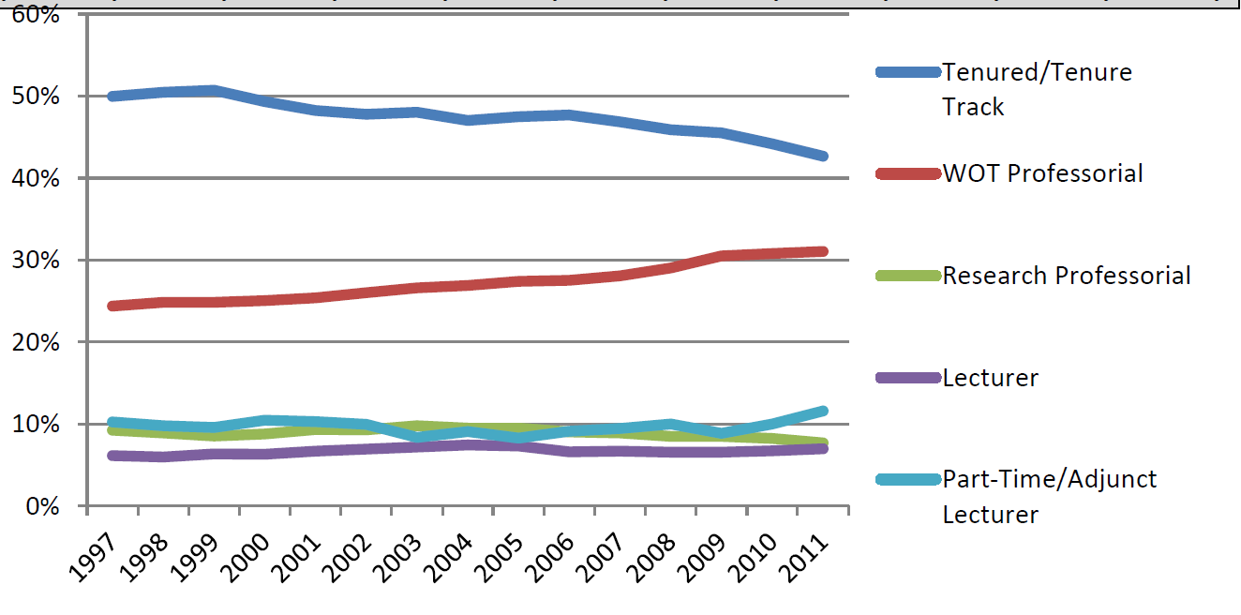
The declining fraction of tenured positions
Core faculty demographics at the University of Washington. Source: UW Office of Planning and Budgeting, available at www.washington.edu/faculty/facsen/issues/fac_dems_senate.pdf

Slide 5
Requirements for tenure
Tenure should be granted to faculty members of such scholarly and professional character and qualifications that the University….can justifiably undertake to employ them for the rest of their academic careers. Such a policy requires that the granting of tenure be considered carefully. It should be a specific act, even more significant than promotion in academic rank, which is exercised only after careful consideration of the candidate's scholarly and professional character and qualifications.
    [from the UW Faculty Code, 25-41A]

Slide 6
Scholarly and professional character and qualifications
Faculty codes tend to be quite vague about what the specific requirements are for tenure
  Acknowledges that there exists a large diversity in what constitutes scholarly work across disciplines
  Acknowledges that tenure decisions are essentially (although not formally) made at the department level
In science, the journal publication is the primary means for assessment of scholarly output at research-intensive universities
In other fields the scholarly book, book reviews, and other output can also be important

Slide 7
Scholarly and professional character and qualifications – beyond publications
Increasingly demonstrable grant funding is becoming important in tenure assessments
  Publications important for obtaining grant funding in today’s more risk-averse funding climate
Letters of reference solicited by the department are critical
  Junior faculty need visibility in their disciplinary community for senior faculty to be able to write strong letters

Slide 8
All journal publications are not equal
Within a given discipline, there are generally journals that are given high status and some that are deemed less worthy
Objective metrics (impact factors etc.) are not necessarily indicative of high status, although there is certainly correlation
However, there is also interesting variation from department to department within a discipline
  In my own department (Atmospheric Sciences), substantial papers in the Journal of Climate (impact factor 4.3) are often seen as more meritorious than short papers in Science or Nature (both IF around 30)
  Other departments rank papers in Science and Nature more highly
With the rise of the rates of publication, tenure-track faculty view time to publication as increasingly important
  Journals cheat the statistics (e.g. rejecting papers so that published time from submission to publication are shorter)
  Many journals have dramatically cut times to publication

Slide 9
All journal publications are not equal
Proliferation of new journals has not had a large impact on tenure at most research-intensive universities in the US
  Those in the field know quality when they see it
However, there have been gamechangers
  All-electronic journals backed by a scientific society (e.g. European Geophysical Union) have risen to become some of the most popular
  Initially, many were skeptical about reviewing standards, but acceptance can quickly be reached once publications by well-respected authors begin to appear

Slide 10
New challenges
In the era of “big data”
  How to reward the creation of datasets, methodologies and software products - typically under-rewarded in academia
  Need new avenues to “publish” and share such creations, and to include them in the portfolio of scholarly output to be evaluated for tenure
  How do we assess individual contributions within large collaborative publications?

Slide 11
The importance of peers
Almost every aspect of the tenure decision is decided by peers
  Journal submission referees
  Letters of reference
  Departmental colleague perceptions

Slide 12
Synthesis
Tenure decisions are reached based on a complex set of evaluations that includes publications, but also increasingly grant funding
New challenges involve adapting to new technology (all-electronic publication, big data, tackling increasingly-complex and multi-faceted problems)

Slide 13
SPARC
The Scholarly Publishing and Academic Resources Coalition - an international alliance of academic and research libraries working to correct imbalances in the scholarly publishing system
FASTR Bill will allow free access to all federally-funded research
  Free online access to all publications from research supported by most federal agencies
  Journals will have 6 month embargo
  Journal-formatted versions do not need to be freely available
More than 60 provosts support the bill, including our own

